Slide 1
Work Experience Information
Mr Baker Assistant Principal I/C Catholic Life & Personal Development

Slide 2
Department for Education:
‘We want all schools to do as the best do:
inspiring young people, providing work experience and putting them in touch with employers.
There is also a challenge to us all:
to respond to the world as it changes,
to inspire, to motivate, to encourage and to create a skilled workforce to compete in the global race’

Slide 3
Why work experience matters:
Self-management
Team work
Business & customer awareness
Problem solving
Communication and literacy
Application of numeracy/technology skills
Gain valuable experience to add to your CV
Building on employability skills

Slide 4
Important Information
Work experience week begins Monday 18th March- Friday 22nd March.
Students may work with a family member but insurance must still in place.
All placements must be within the UK
The employer must have Employer Liability Insurance and Public Liability Insurance.
Any student who hasn’t found a placement, will be expected to attend school.

Slide 5
Unifrog and The Placements tool

Slide 6
What is Unifrog?
Unifrog is an online careers platform used by over half of the secondary schools and colleges in the UK. The platform has various tools to help students research careers and future pathways, draft CVs and personal statements, and manage work experience.
The school will start to use the platform this year. Every student will receive their own log in.
2 min Unifrog overview video

Slide 7
Using the Unifrog Placements tool
On Unifrog, the Placements tool helps schools, students, parents and employers to organise work experience.
2 min overview of the tool
Over 1000 schools use this tool to organise work experience, and 90,000+ placements have been processed through the tool.

Slide 8
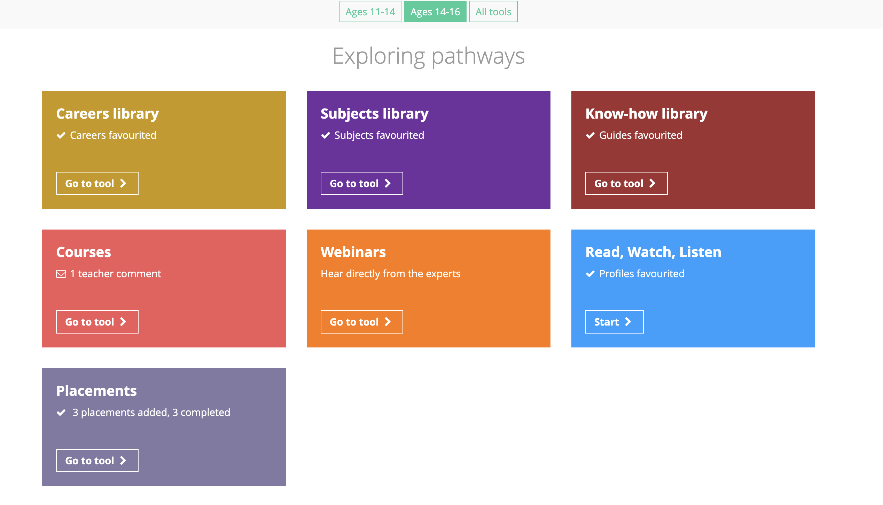
Using the Unifrog Placements tool
Students will have received their Unifrog logins
After the student has informally agreed a placement, they will need to log into their Unifrog profiles to log the Placement. Here’s what happens next.

Slide 9
Next steps
Students
Log into Unifrog via a welcome email in school once logins are ready.
Source a placement and log the information on Unifrog.
Parents/Carers
Support your child to source a placement. Encourage them to log it on Unifrog.
Look out for an email from Unifrog once the student and the employer have completed their forms.

Slide 10
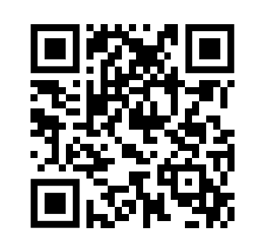
More info
Unifrog have created a set of guides about placements which you can find here.
Within this set of guides, this is the best one to start with (it includes a short animation of how the whole process works).
Next we recommend looking at this one, because it includes advice on how to find a placement.
Pro tip: check out the apprenticeships tool on Unifrog to research local employers who may be open to hosting a placement.
QR codes to guides

Slide 11
Local work experience opportunities are right on your doorstep
Solicitors
Multiple local law firms in your area could allow you the opportunity to experience such a career firsthand.
Education
Your own school can also take you on
for experience if you have an interest in the educational system.
Restaurant/Café
Work experience in a café or restaurant
can offer great experience if you have interest in the service sector.
Art & Design
There are many creative studios that would love to have young talent on board for work experience..
Accountancy Firms
Some accountancy firms in your local area may allow you to obtain valuable experience in a growing industry.
Hair & Beauty
Even local hair salons are interested In taking on people for work experience. Which could even lead to a job afterwards.
Engineering
If you are seeking a potential career in engineering. There could be plenty of local engineering companies near you.

