Slide 1

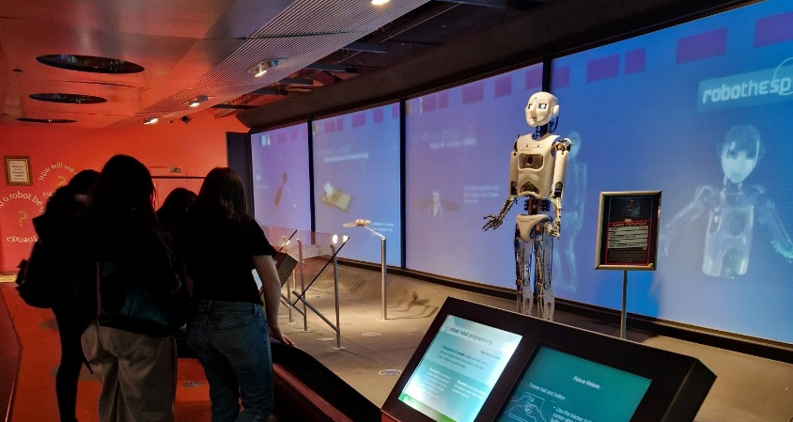
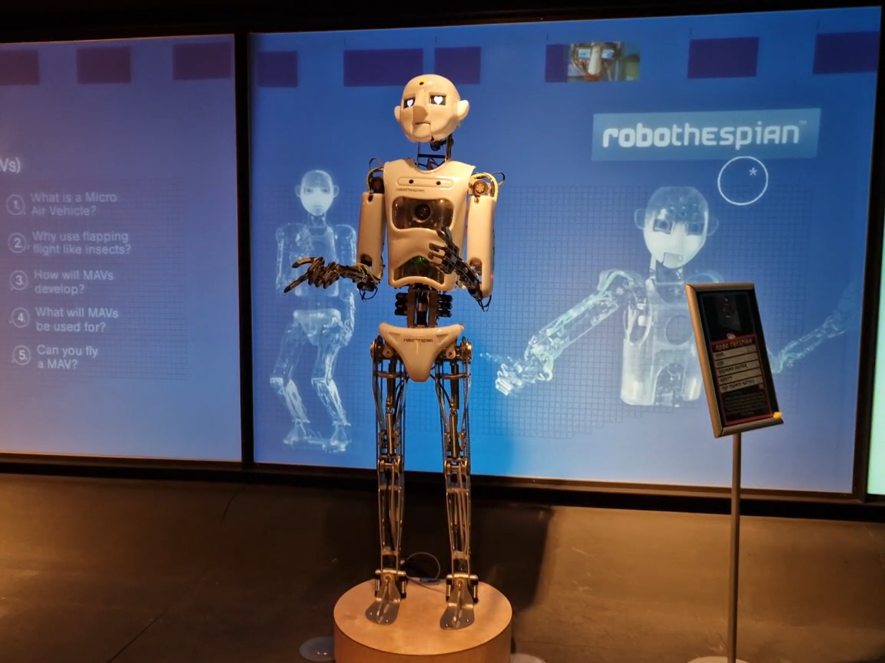
Year 9 Options 2026-2028
Computing
‘Inspiring hearts and minds with Christ at the centre of all we say and do’

Slide 2
Course and Qualification Information
Pearson BTEC Tech Award Level 1/2 in Digital Information Technology
The Pearson BTEC Level 1/Level 2 Tech Award in Digital Information Technology (603/7050/6) is designed for learners who wish to develop practical, sector-specific knowledge and skills through vocational contexts. As part of their Key Stage 4 studies, learners explore areas such as project planning, data management, data interpretation, data presentation, and data protection.
This Tech Award allows learners to build applied, sector‑specific knowledge and skills through practical, realistic digital scenarios. This Tech Award supports and enhances learning from GCSE programmes, including GCSE Computer Science. It provides an introduction to applying project planning techniques to design and develop user interfaces, as well as how to collect, present and interpret data and how digital systems are used.
‘Inspiring hearts and minds with Christ at the centre of all we say and do’

Slide 3
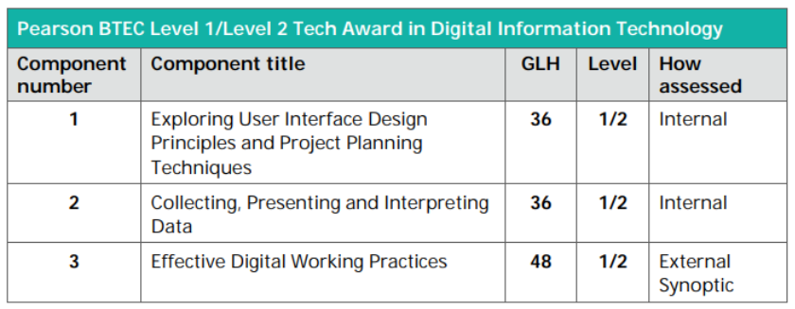
Assessment Information
*GLH – Guided Learning Hours
Internal assessments – Coursework completed under controlled conditions.
External assessment – Exam completed at the end of the course.
‘Inspiring hearts and minds with Christ at the centre of all we say and do’

Slide 4
Extra Curricular Opportunities
Coding and App Development Club
Lunch Time Support Sessions
After school Support Sessions
Industry Visits and Guest Speakers
Gaming Club
‘Inspiring hearts and minds with Christ at the centre of all we say and do’

Slide 5
Next Steps and Career Pathways
Studying the BTEC Tech Award in Digital Information Technology can lead to a wide range of digital and technology‑related careers. It helps learners build practical skills that are useful in many modern workplaces. Possible future pathways include:
Learners can progress to:
Level 2 or Level 3 IT and Computing courses
BTEC National qualifications in ITA‑Levels such as Computer Science or Business
Apprenticeships in IT support, digital marketing, or software development
This qualification provides a foundation for careers such as:
IT Support Technician – helping people solve technical problems
Web or UX Designer – designing websites and user interfaces
Data Analyst Assistant – working with data to help organisations make decisions
Software or App Development Trainee – contributing to digital products
Cyber Security Assistant – supporting online safety and protection
Digital Marketer – creating and managing online content
Network Technician – helping to set up and maintain computer networks
Project Support Assistant – helping manage digital projects
‘Inspiring hearts and minds with Christ at the centre of all we say and do’

Slide 6
Additional Information and Outcomes
The BTEC Level 1/Level 2 Tech Award in Digital Information Technology provides learners with practical experience and knowledge that can be applied in real-world digital contexts. Through the course, learners complete projects that develop skills in planning, managing, interpreting, presenting, and protecting data. This hands-on approach helps them build confidence in using technology, problem-solving, and working independently or in teams. On completion, learners gain a recognised qualification that supports further study, such as GCSEs or Level 3 vocational courses, and prepares them for future career opportunities in digital and IT-related fields.
‘Inspiring hearts and minds with Christ at the centre of all we say and do’

Slide 7
Frequently Asked Questions
What is the BTEC Tech Award in DIT?
It is a practical, skills based qualification that teaches how digital information is created, used and managed in real world situations.
2. How is the course assessed?
  Two internal coursework units, marked in school.
  One external exam, set and marked by Pearson.
3. What skills will I learn?
You will learn:
  How to design user interfaces
  How to collect, analyse and present data
  How digital systems work in organisations
  Project planning and problem solving
  Cyber security and safe working practices
4. Is there a lot of writing?
The course includes written explanations, but most work is practical, involving designing, creating and evaluating digital products.
5. How is this different from GCSE Computer Science?
GCSE Computer Science focuses more on programming and theory.
BTEC DIT focuses on applied digital skills, design, data and practical tasks.
6. What grades can I achieve?
You can achieve:
Level 1 Pass, Merit, Distinction
Level 2 Pass, Merit, Distinction or Distinction
‘Inspiring hearts and minds with Christ at the centre of all we say and do’

