Slide 1
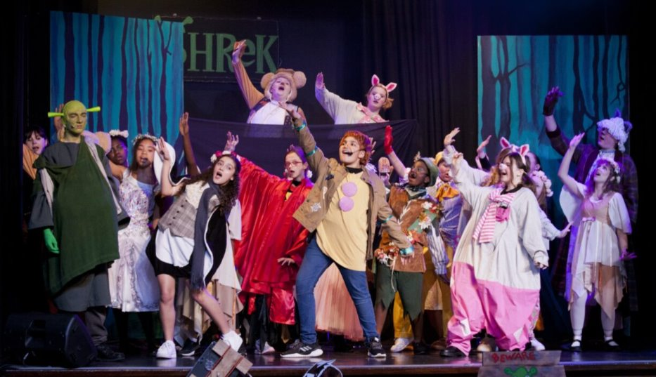
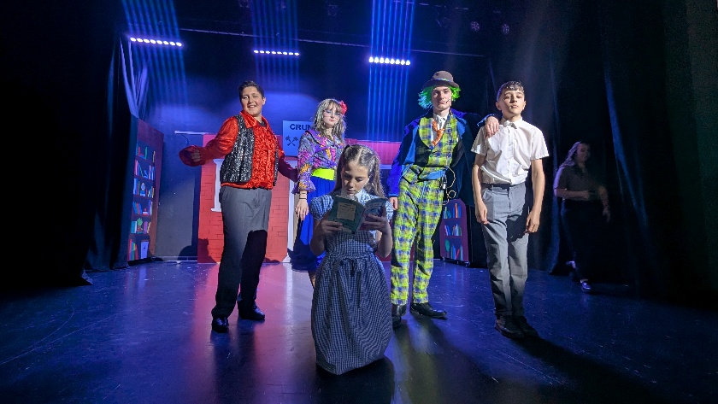
Year 9 Options 2026-2028
DRAMA
‘Inspiring hearts and minds with Christ at the centre of all we say and do’

Slide 2
Course and Qualification Information
The GCSE course is a fantastic blend of practical and theoretical work. Over the two years you will act, create, reflect, devise, design, analyse and evaluate your work, your peers and professional work. ​
​
We will practically explore in lesson time plays, practitioners, themes, issues and stimuli to deepen your understanding of different genres/styles and contexts. ​
​
You will explore performance skills, designing skills, explorative strategies and staging.​
​
We will visit the theatre and watch examples of live theatre productions both live and pre recorded to broaden your experience of the theatre. ​
​
We will build up written skills, writing from the perspective of anactor, designer and theatre critic to prepare you will for your devising log and written exam! ​
​
Hopefully you will have fun, develop as a performer, creator and reflector!
‘Inspiring hearts and minds with Christ at the centre of all we say and do’

Slide 3
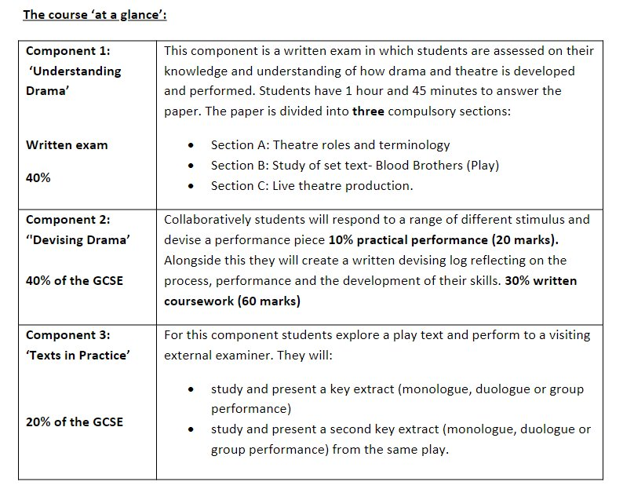
Assessment Information
‘Inspiring hearts and minds with Christ at the centre of all we say and do’

Slide 4
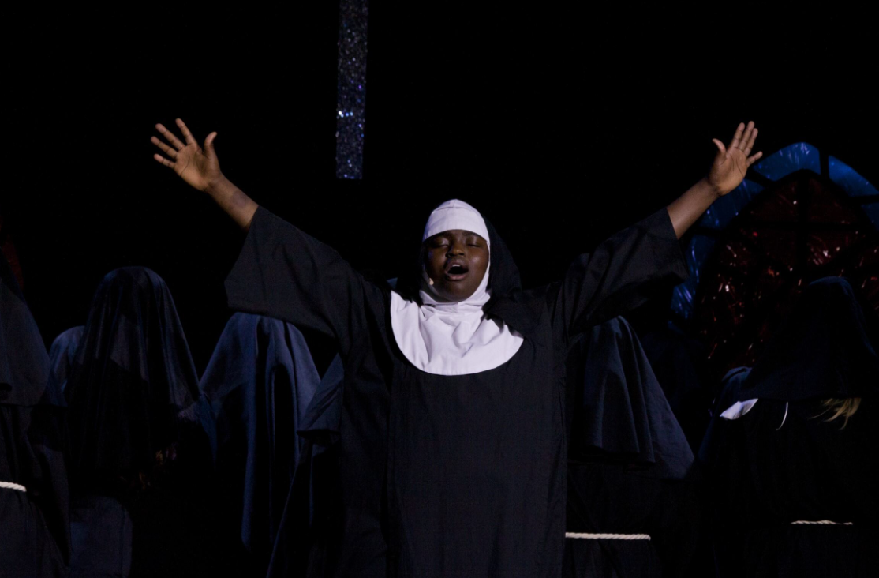
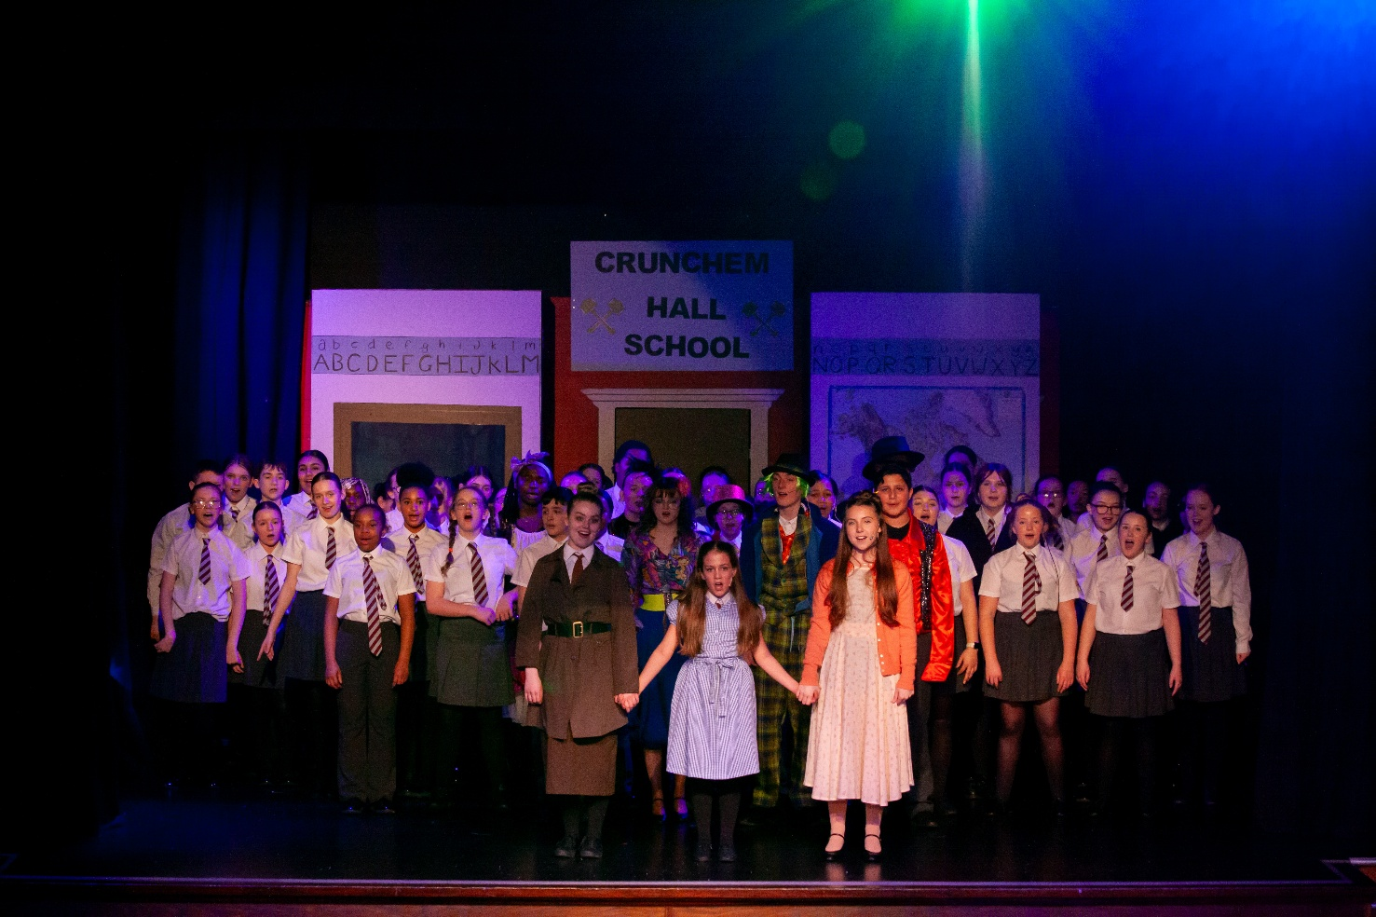
Extra Curricular Opportunities
‘Inspiring hearts and minds with Christ at the centre of all we say and do’

Slide 5
Next Steps and Career Pathways
Drama at KS5 ​ | University ​ | Career​
A Level Drama ​ A Level Theatre Studies ​ BTEC Performing Arts​ BTEC Acting ​ Drama and Theatre studies A Level ​ | Potential degrees:​ Playwriting​ Devising and physical theatre​ Acting for stage​ Post dramatic performance: composed theatre​ Theatre skills​ Drama in context​ Theatre making: scenography and technology​ Shakespeare​ Performance: from ritual to spectacle​ Stage and screen productions​ ​ | Actor ​ Director ​ Theatre in education practitioner ​ Lighting designer/ technician ​ Costume designer ​ Theatre make up ​ Stage manager ​ Scriptwriter ​ Lawyer ​ Lecturer ​ Teacher​
‘Inspiring hearts and minds with Christ at the centre of all we say and do’

Slide 6
Additional Information and Outcomes
Drama
Develops the whole person
Fosters a spirit of co operation and builds teamwork
Deepens your ability to empathise
‘Inspiring hearts and minds with Christ at the centre of all we say and do’

Slide 7
Frequently Asked Questions
Is the course all about performing?
No, this is a common misconception! Comp 3 is 20% practical which is externally assessed by an examiner (however you can be assessed as a designer) Comp 2 is 80% theory 20% practical and comp 1 is 100% written. In your lessons you will be expected to engage in practical exploration.
What opportunities is drama going to provide me with?
- Even if you don’t want to act, direct, script write, present! Drama will enrich your knowledge and understanding of theatre, the world, themes/ issues and develop you into a critical thinker (analysing and evaluating live theatre). Confidence, the ability to improvise and work well under pressure. Speak well in front of others and learn more about people, cultures, contexts and issues that impact the world!
I am not very good with my writing, how will I cope with the exam?
- With support, guidance and lots of practice you will get there ☺ Section A is knowledge of the theatre, section B requires you to write in role offering creative and justified practical ideas. Section C expects you to analyse and evaluate live theatre being critical and showing your knowledge and understanding of how meaning is created on stage.
‘Inspiring hearts and minds with Christ at the centre of all we say and do’

