Slide 1

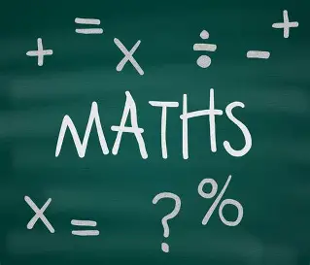

Year 9 Options 2026-2028
Mathematics
‘Inspiring hearts and minds with Christ at the centre of all we say and do’

Slide 2
Course and Qualification Information
Pearson Edexcel Level 2 GCSE (9-1)
In Mathematics (1MA1)
Subject content
1 Number
2 Algebra
3 Ratio, proportion and rates of change
4 Geometry and measures
5 Probability
6 Statistics
‘Inspiring hearts and minds with Christ at the centre of all we say and do’

Slide 3
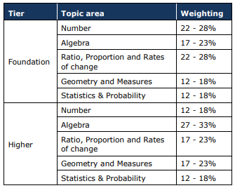
Assessment Information
Foundation Grades 1 – 5
Higher Grades 3 - 9
‘Inspiring hearts and minds with Christ at the centre of all we say and do’

Slide 4

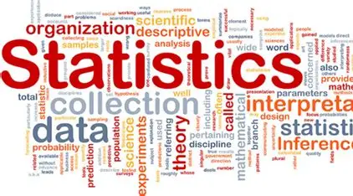


Extra Curricular Opportunities
UKMT Intermediate Maths Challenge
Statistics
Maths in Action
Chess
‘Inspiring hearts and minds with Christ at the centre of all we say and do’

Slide 5
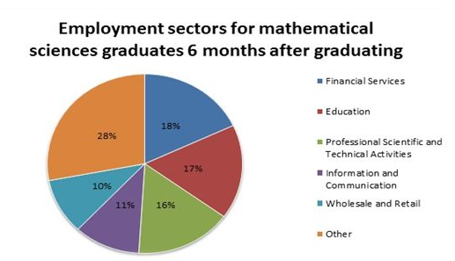
Next Steps and Career Pathways
‘Inspiring hearts and minds with Christ at the centre of all we say and do’
Notes:
As you can see from the infographic, a grade 4 is a standard pass and a grade 5 is a strong pass. A grade 4 in mathematics is essential for many jobs, courses and pathways after GCSE. If you do not achieve grade 4 or above you will have to continue to study maths so it is much easier to pass while you are still at school as you will get more support from your teacher and the maths department.
The study of GCSE Mathematics at Higher Tier naturally lends itself to studying mathematics at A Level here at the College’s Sixth Form. A Level Mathematics builds on existing knowledge from the GCSE and introduces some exciting new branches of pure mathematics such as the binomial expansion and calculus and also an applied mathematics called mechanics, which is essentially the mathematics of things that move.
Accountant, Financial analyst, Banker, Actuarial analyst, Statistician, Academic researcher, Engineer, Meteorologist, Teacher, Astronomer, Data analyst, CAD technician, Game designer, Quantity surveyor, Software tester, Medicine and Health, Market researcher, Pilot, … the list is endless! Employers will always look favourably at potential employees with qualifications in mathematics.

Slide 6
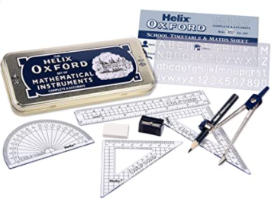
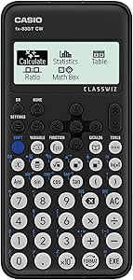
Additional Information and Outcomes
Essential Equipment
A black pen
A pencil
A ruler
An eraser
A pencil sharpener
A scientific calculator (Casio FX-83GTX Scientific Calculator)
Grade | %
9 – 7 | 15
9 – 5 | 45
9 – 4 | 67
‘Inspiring hearts and minds with Christ at the centre of all we say and do’
Notes:
It is very important that you are equipped for all your lessons. Each lesson you must bring:
A black pen
A pencil
A ruler
An eraser
A pencil sharpener
A scientific calculator (Casio Classwiz FX-83GTX Scientific Calculator) this is highly recommended and can be used in most, if not all, of your other GCSE subjects)
There are some topics in maths that require technical drawing and measuring and therefore we recommend that you also have a geometry set that includes a protractor and a pair of compasses.
Being prepared for lessons gives you best chance to develop your God-given talents in mathematics and the results from the table show that previous groups of learners have achieved some fantastic grades. In 2019 almost 1 in 5 students obtained grade 9-7 and in 2020 a huge 82% of students gained a standard pass or above.

Slide 7
Frequently Asked Questions
How much homework will I get?
Homework will be assigned weekly and will help students to consolidate learning from lessons or prepare for future lessons.
How do I revise for maths?
The easiest way to revise for maths is to do some questions. Try to complete questions on basic skills first as jumping in on the hardest questions first may just put you off doing anymore revision. The maths team will recommend various websites and resources when the time is right.
Can I achieve a grade 6 if I sit the Foundation papers?
Unfortunately, the answer to this question is no. The foundation tier only grades from 5 to 1 and the higher tier grades from 9 to 4.
Can I switch tiers of entry midway through the course?
The simple answer to this is… not easily. If you believe you are on the wrong pathway you must speak to me or your maths teacher immediately to discuss your options.
‘Inspiring hearts and minds with Christ at the centre of all we say and do’

