Slide 1
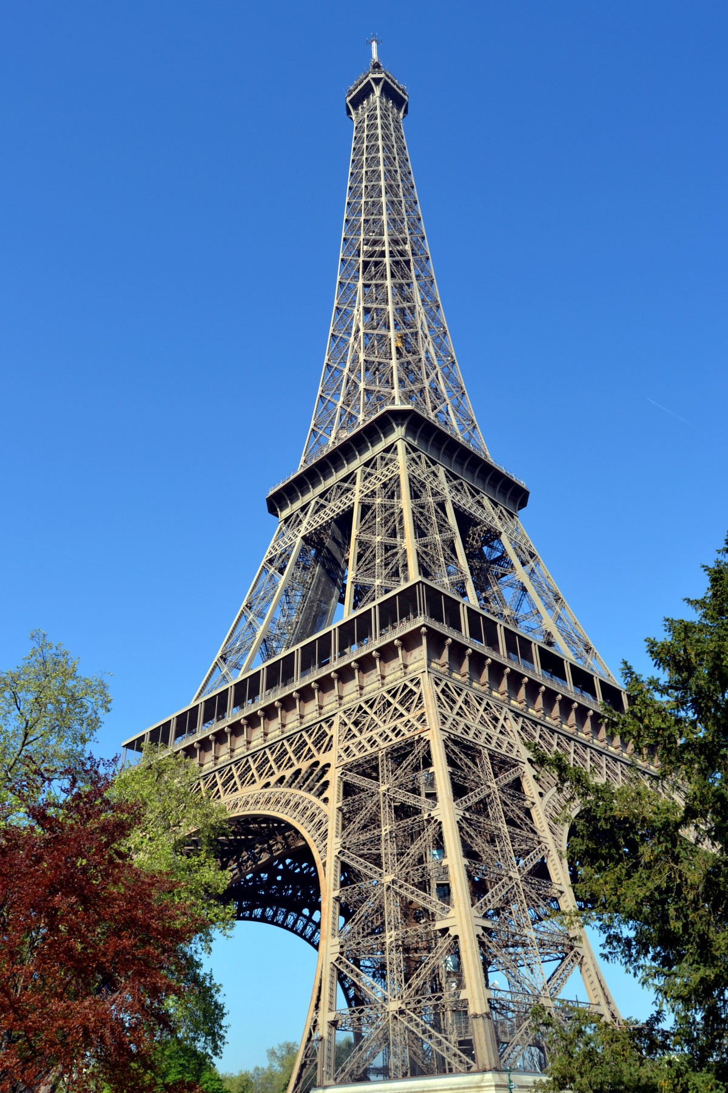


Year 9 Options 2026-2028
MFL
‘Inspiring hearts and minds with Christ at the centre of all we say and do’
Notes:
My name is Miss Duyimana, and I am the Head of Modern Foreign Languages. Thank you very much for being here this evening.
Today, I’m going to introduce you to the French GCSE course—what it involves, how it is structured, and most importantly, why choosing French can be such a valuable and rewarding decision.
In this presentation, I will give you a clear overview of the course content, how students are assessed, and the kind of skills they will develop over the two years. I will also highlight the wider benefits of learning French, including how it can support employability and help students stand out in an increasingly competitive and global job market.
Let’s get started.

Slide 2

Course and Qualification Information
Course length: 2 years (Years 10–11)
Exam board: Edexcel
Topics:
    Theme 1: My personal world
    Theme 2: Lifestyle and wellbeing
    Theme 3: My neighbourhood
    Theme 4: Media and Technology
    Theme 5: Studying and my Future
    Theme 6: Travel and Tourism
‘Inspiring hearts and minds with Christ at the centre of all we say and do’
Notes:
the French GCSE is studied across Years 10 and 11, allowing students to gradually build their skills and confidence in speaking, listening, reading, and writing.
We follow the Edexcel exam board, which offers a well-balanced course with a strong focus on real-life communication—helping students use French in practical, meaningful contexts.
The course is organised into six main themes. These topics are designed to be relevant to students’ lives and future aspirations.
Students begin with topics about themselves and their everyday lives, before moving on to areas such as health, their local environment, and the role of media and technology in modern society.
As they progress, they will also explore future plans, education, careers, and finally travel and tourism—giving them the language skills they would need in real-world situations abroad.
Overall, the course is designed not just to help students succeed in exams, but to give them the confidence to communicate effectively in French beyond the classroom.

Slide 3
Assessment Information
All four skills are equally important: You will be assessed on the four language skills:Listening:25%; Speaking – 25%; Reading 25 %; Writing 25%
Final exams at the end of Year 11
Regular practice and mock exams along the way
The exams are tiered so you will either take
the Foundation Examination (up to a grade 5) or
the Higher Examination (grade 3 to a grade 9).
‘Inspiring hearts and minds with Christ at the centre of all we say and do’

Slide 4
Extra Curricular Opportunities
Mentoring and
leadership
opportunities
Language
ambassadors
The more you do, the more you are.
‘Inspiring hearts and minds with Christ at the centre of all we say and do’
Notes:
Beyond the classroom, we also offer a range of exciting extra-curricular opportunities within the Modern Foreign Languages department.
On a voluntary basis, students have the opportunity to prepare and deliver presentations in school assemblies. This is a fantastic way to build confidence and develop public speaking skills—an ability that is highly valued in both education and future careers.
We also encourage students to take on leadership roles as student ambassadors. In this role, they help to promote languages across the school, support events, and act as positive role models for younger students.
We place a strong emphasis on mentoring and leadership development. Older students are often given the chance to support and guide younger learners, helping to build both confidence and responsibility.
Students may also have the opportunity to complete their work experience within the department, working as teacher assistants. This provides valuable insight into teaching and helps them develop important skills such as communication, organisation, and teamwork.
All of these opportunities are designed to help students grow not just academically, but personally—equipping them with skills that will benefit them well beyond their GCSEs.

Slide 5
Next Steps and Career Pathways
Careers
• Business
• Travel & Tourism
• Translation
• Teaching
• Media
• Retail
WHY choose French?
• Keeps options open
• Valued by employers
• Supports other subjects
‘Inspiring hearts and minds with Christ at the centre of all we say and do’
Notes:
A study found that French is one of the top 3 most in-demand second languages for employers in the UK, appearing in nearly a quarter of multilingual job postings. Research also shows that French is among the highest-paying second languages, with typical salaries around £40,000–£50,000 and often above the UK average. The job market has become increasingly competitive and international, and research by the University of Portsmouth found that many UK job adverts now list a second language as a requirement or necessity, rather than simply desirable.

Slide 6
Additional Information and Outcomes
You will be able to communicate with others confidently.
You will be become more open minded and culturally aware.
You will be able to think and write flexibly and creatively.
You will develop your knowledge of grammar in English and French.
You will improve your listening and reading skills and apply those to different contexts.
You will be able to identify patterns and apply it to different situations.
You will improve your memory and problem-solving skills.
You will further develop good study skills and the ability to work and learn independently.
‘Inspiring hearts and minds with Christ at the centre of all we say and do’
Notes:
As students move into Key Stage 4, choosing their options is an important step. The subjects you select now can open doors later on—whether that’s for further study, travel, or future careers. French is one of those subjects that offers both practical skills and long-term opportunities. Whether you already enjoy languages or are still deciding, I hope this session have given you a better understanding of what studying French GCSE is really like and that it helps you make an informed choice. Au revoir!

Slide 7
Frequently Asked Questions
1. “Is GCSE French too difficult if my child isn’t naturally good at languages?”
Answer:
Not at all. Pearson Edexcel courses are designed to support all ability levels. Students:
Build gradually on Key Stage 3 knowledge
Learn vocabulary in structured, manageable topics
Practise key skills regularly in class
2. “What are the benefits of taking French for my child’s future?”
Answer:
GCSE French is highly valued because it shows:
Strong communication skills
Problem-solving ability
Cultural awareness
It supports future pathways such as:
Business and international work
Travel and tourism
University applications (many top universities value a language GCSE)
‘Inspiring hearts and minds with Christ at the centre of all we say and do’

