Slide 1
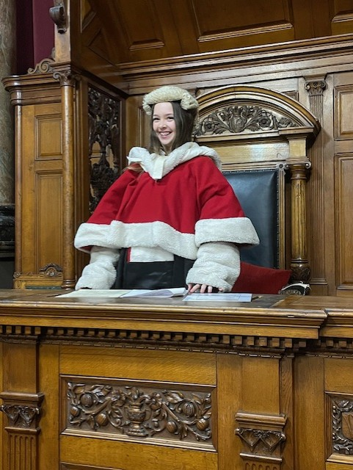
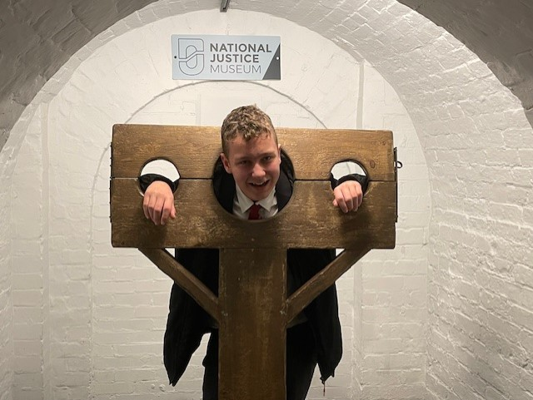
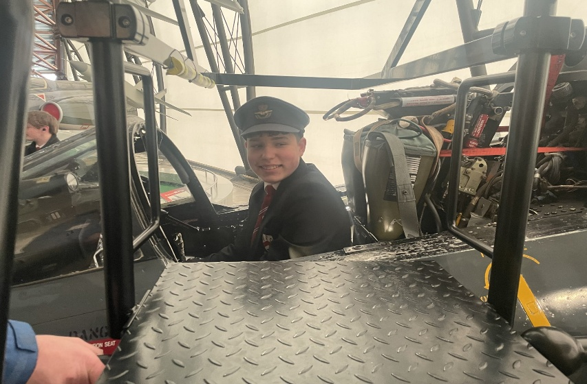
Year 9 Options 2026-2028
GCSE History
‘Inspiring hearts and minds with Christ at the centre of all we say and do’

Slide 2
Course and Qualification Information
GCSE Edexcel History
Unit 1: Crime and Punishment Throughout Time
Unit 2: The early reign of Elizabeth I
Unit 3: The Cold War and Superpower Relations
Unit4: Weimar and Nazi Germany
‘Inspiring hearts and minds with Christ at the centre of all we say and do’

Slide 3
Assessment Information
The course is fully exam based.
There are three exams at the end of the course
Crime and Punishment Throughout Time – 1h 20 minutes = 30% of overall grade
The reign of Elizabeth I and The Cold War combined – 1h 50 minutes = 40% of overall grade
Weimar and Nazi Germany – 1h 30 minutes = 30% of overall grade
‘Inspiring hearts and minds with Christ at the centre of all we say and do’

Slide 4
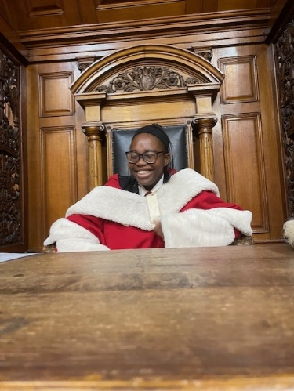
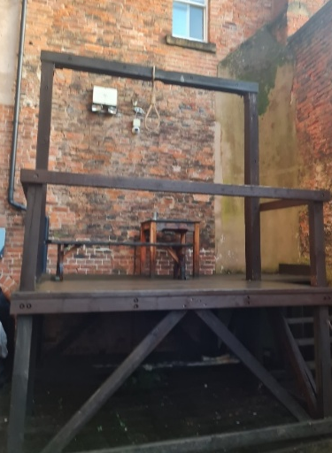
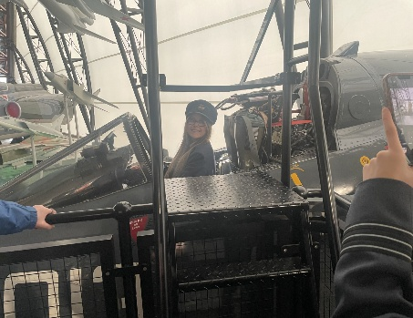
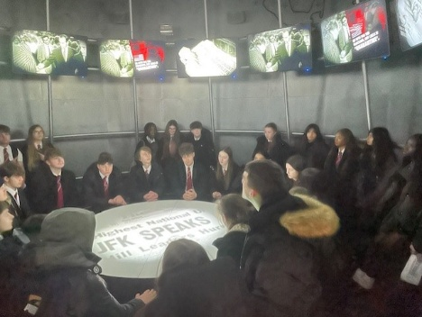
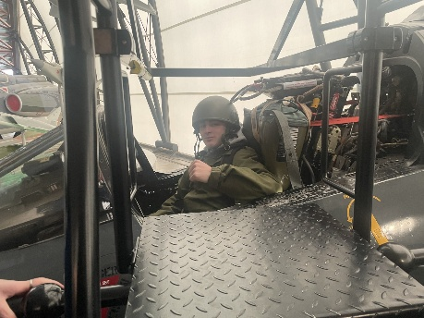
Extra Curricular Opportunities
There are two trips during the course:
Year 10
National Justice Museum in Nottingham
Year 11
RAF Cosford
‘Inspiring hearts and minds with Christ at the centre of all we say and do’

Slide 5
Next Steps and Career Pathways
GCSE History leads into many different career pathways:
A-Levels, degrees and apprenticeships.
Future Careers include:
Lawyer
Solicitor
Journalist
Archaeologist
Archivist
‘Inspiring hearts and minds with Christ at the centre of all we say and do’

Slide 6
Additional Information and Outcomes
GCSE exam results are above national, local and regional average.
9-7 – 30% of our students achieved grade 7 or above.
9-4% - 68% of our students achieved at least a grade 4.
‘Inspiring hearts and minds with Christ at the centre of all we say and do’

Slide 7
Frequently Asked Questions
Is the course suitable for me?
- You will need to show an interest in the subject.
- You will need to be able to read and write at a good level.
- You will need to be prepared to revise and memorise large amounts of information.
- You will need to be prepared to write in depth and at length.
- Students that are good at English tend to do well at History.
‘Inspiring hearts and minds with Christ at the centre of all we say and do’

