Slide 1

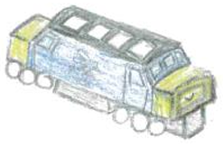
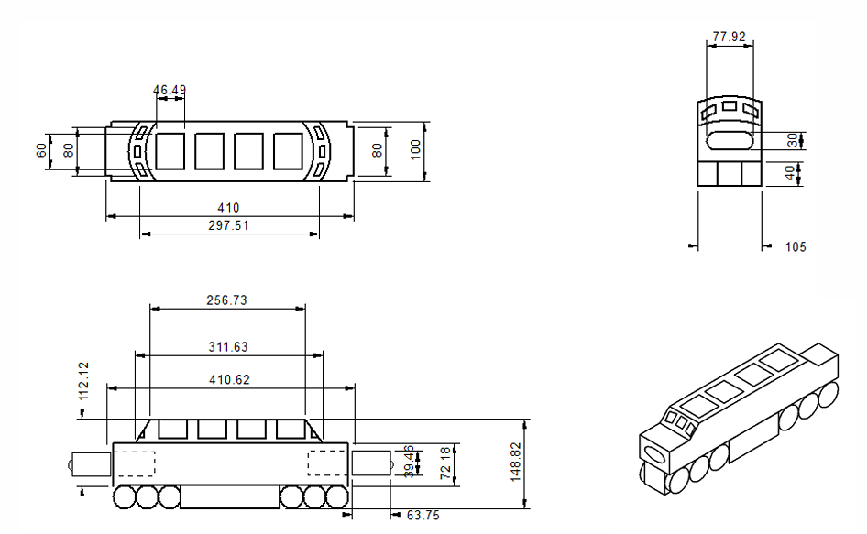
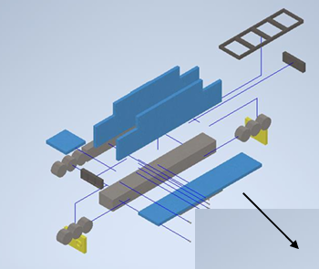
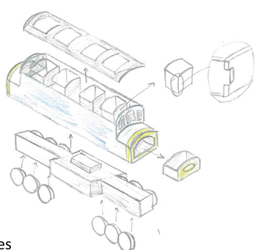
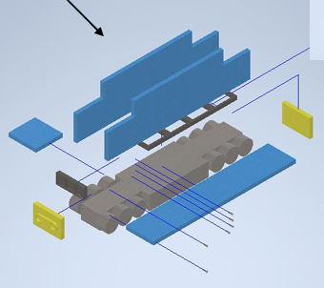
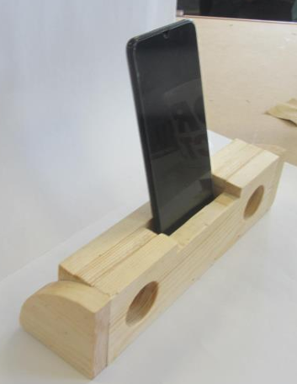
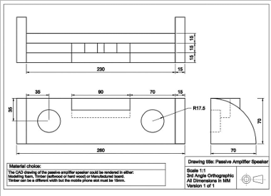
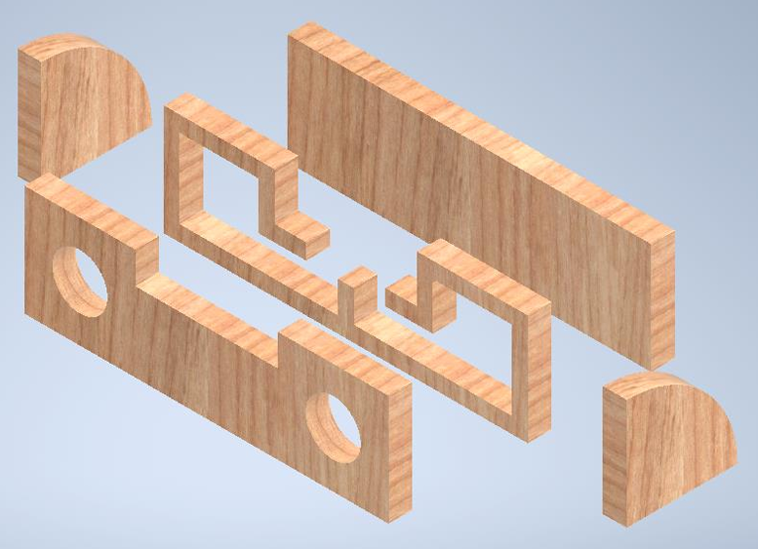
OCR Cambridge National in Engineering Design

Slide 2
OCR Cambridge National in Engineering Design
Engineering is so huge that it’s often hard to define, however most know it to be the practical application of Maths, Science & design disciplines (STEM) and is massively relevant in our ever-changing world.
The Engineering, manufacturing and creative industries make up roughly £400 billion of the UK economy, which equates to roughly 25%

Slide 3
OCR Cambridge National in Engineering Design (New spec)
This course has been designed & tailored by Engineers and has proved a choice popular with students since its implementation, as students are able to succeed at every level & the course provides several clear pathways into further educations, training & apprenticeships.

Slide 4

Who would be suited to this course? Is this for me..
Students who are interested in how products/systems work
Students who enjoy designing & making
Students who are interested in recording their creative journey in an e-portfolio
Students who enjoy diverse & interesting projects
Students who enjoy set workshop tasks & processes
Students who would enjoy spending the whole of KS4 developing one product/completing one project.
Students who want to follow an iterative design process, test what they make & then improve it several times.

Slide 5
Design Engineering (OCR Cambridge National) Level 2.
Nationally recognised qualification, both in Further education and places of business. Can be built on at every stage up to degree level.
Everyone gets something.
Level 1 is half a GCSE. Can be built on at college.
Level 2 is GCSE level. Can be built on at college. (this is us)
Level 3 is an A Level

Slide 6
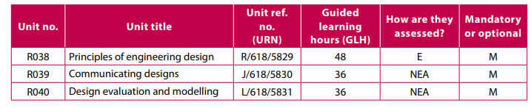
Design Engineering (OCR Cambridge National) Level 2

Slide 7
Design Engineering (OCR Cambridge National) Level 2
R038: Principles of Engineering Design – Exam content. (1hr15)
R039: Communicating Designs – Design portfolio on Powerpoint
Analysis of a design specification
Evidence a range of creative design skills & techniques
How to produce a range of manufacturing drawings
Completing a design using Computer Aided Design (CAD)
R040: Design evaluation & modelling – Portfolio on Powerpoint
Primary & secondary analysis of a product
Product disassembly
Model a product made from several parts

Slide 8
Design Engineering (OCR Cambridge National) Level 2
R039: Communicating Designs – Design portfolio produced on Powerpoint
Analysis of a design specification
Evidence a range of creative design skills & techniques
How to produce a range of manufacturing drawings
Completing a design using Computer Aided Design (CAD)

Slide 9
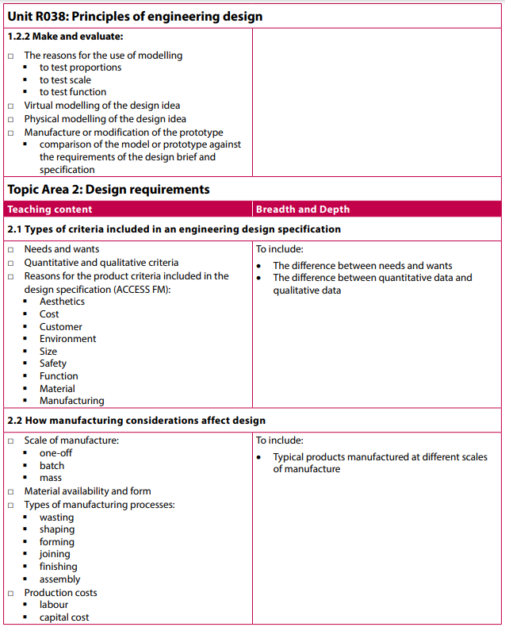
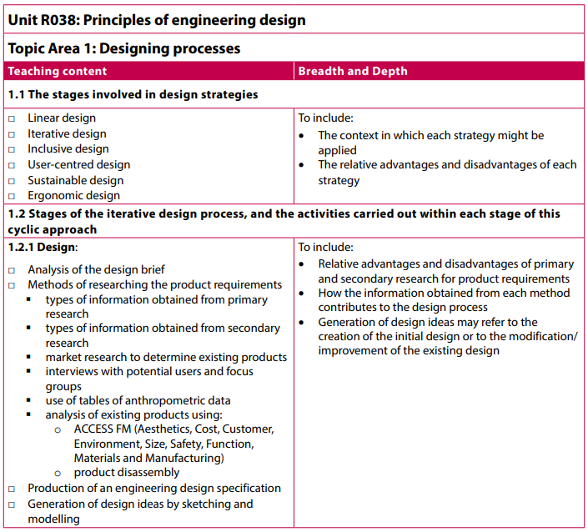
R038 Principles of Engineering Design – Exam Content

Slide 10
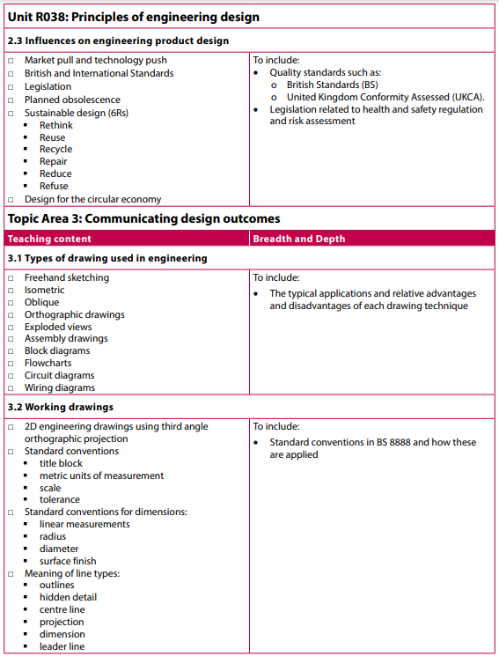
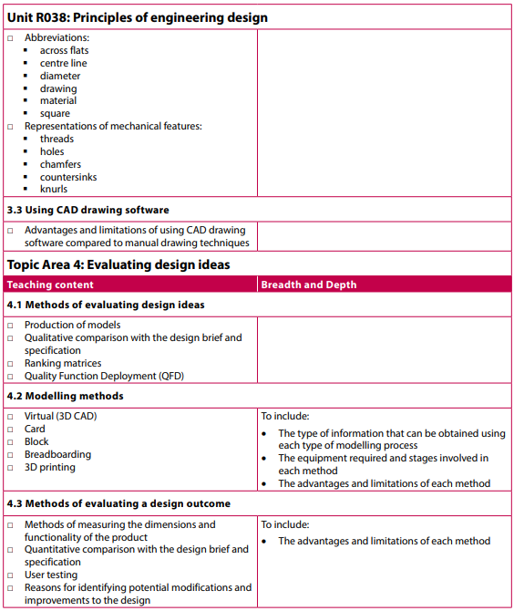
R038 Principles of Engineering Design – Exam Content

Slide 11
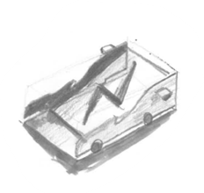
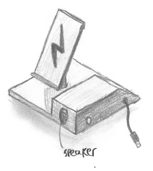
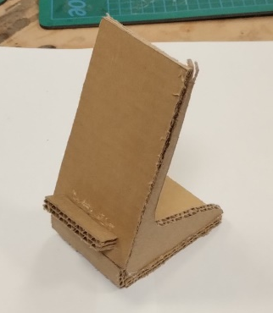
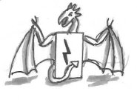

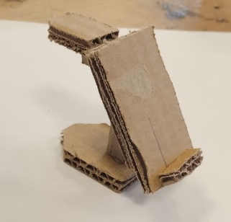
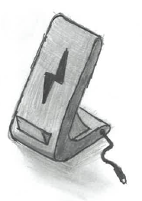
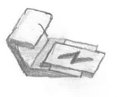

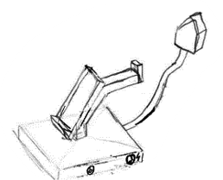
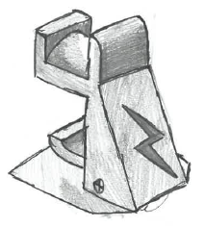
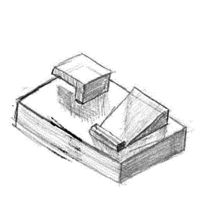
R039: Communicating Designs – Charging dock with extra function
The charger stand is tapered to prevent the phone from falling off and it provides aesthetic appeal. The built in speaker allows you to play music while charging your phone
The shell is vacuum formed out of thermosetting plastic to give it rigidity and allow it to be bulk produced
I also made some card quick models to prototype some of my designs so that I could visualise what they looked like before I committed to making one.
Wide stable base (100 x 100 mm) to sit on worktops
inspired by games controller to appeal to younger audience
Mechanically screwed together instead of being permanently fixed with glue to allow it to be disassembled for repair or recycling,
The tail on the dragon is designed to secure the phone into the charger to stop it falling off
includes a watch charger as a secondary purpose
As a secondary function, it charges wireless headphones.

Slide 12

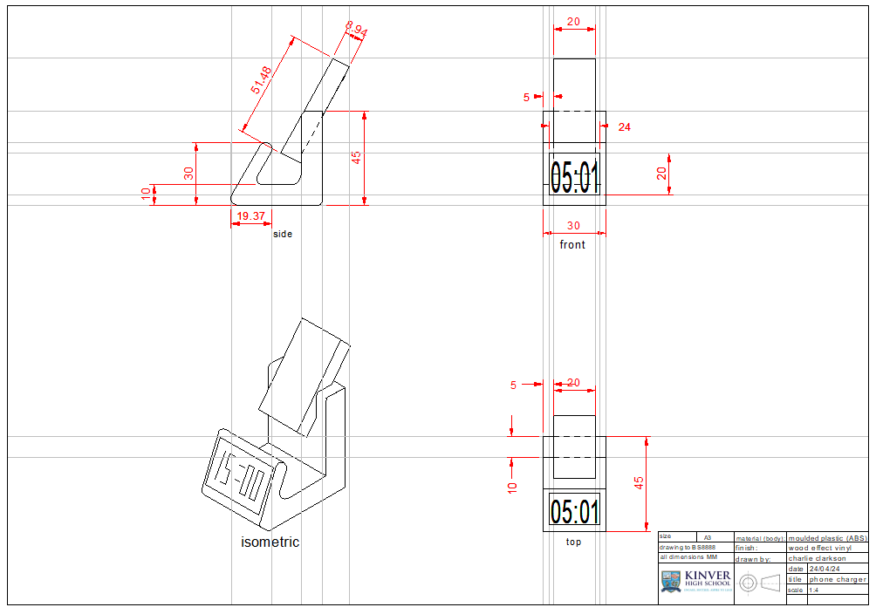
R039: Communicating Designs – Exploded View

Slide 13
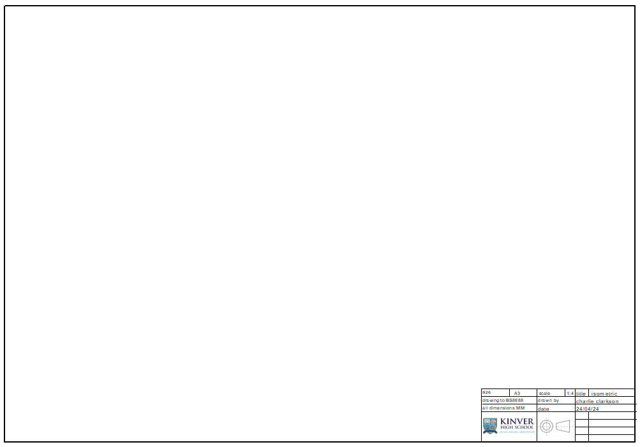
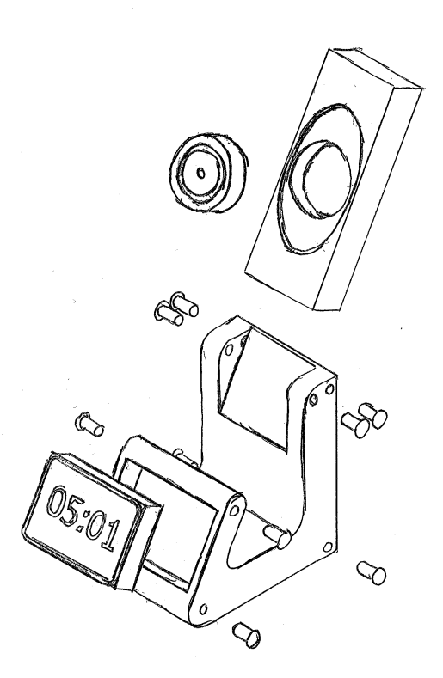
R039: Communicating Designs – Exploded View
Part name | Dimensions | Material/finish
base | 45 x 45 x 30 | Plastic laminate (wood effect vinyl)
Clock/ touchscreen display | 24 x 20 x 5 | Aluminium, touchscreen display
screw | 2.5(diameter) x 5 | Polished aluminium
Charger board | 51.48 x 8.94 x 20 | Matte grey, gold metallic detailing
Charging coil | 15.96 x 5 | Matte black, gold detailing

Slide 14

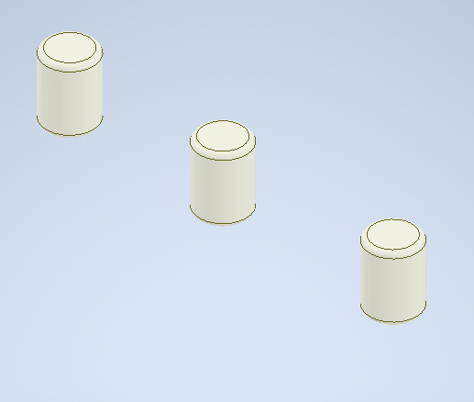
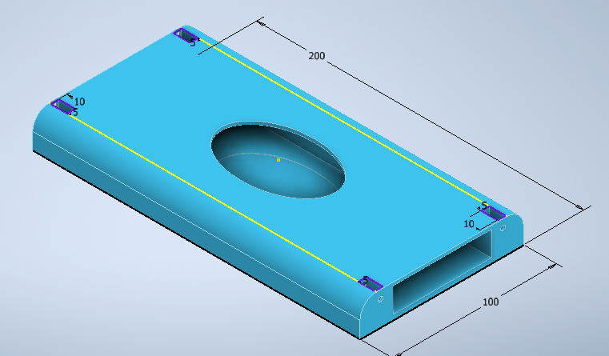
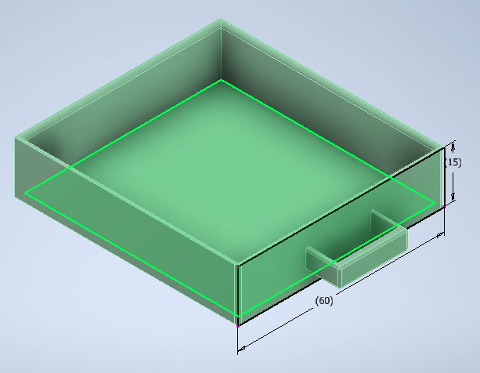
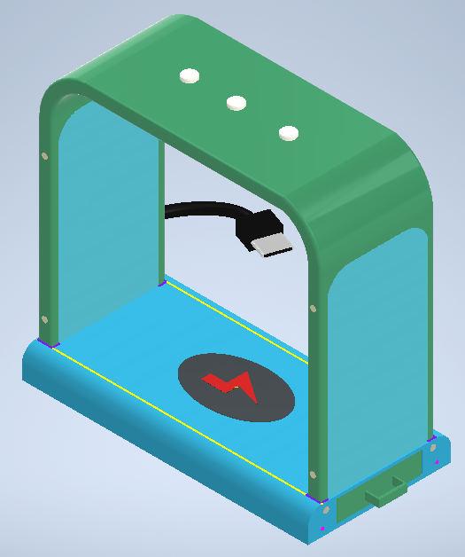
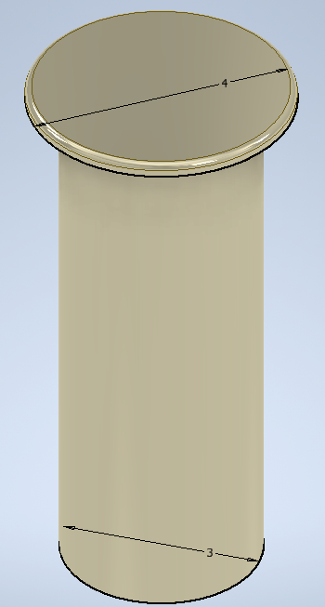
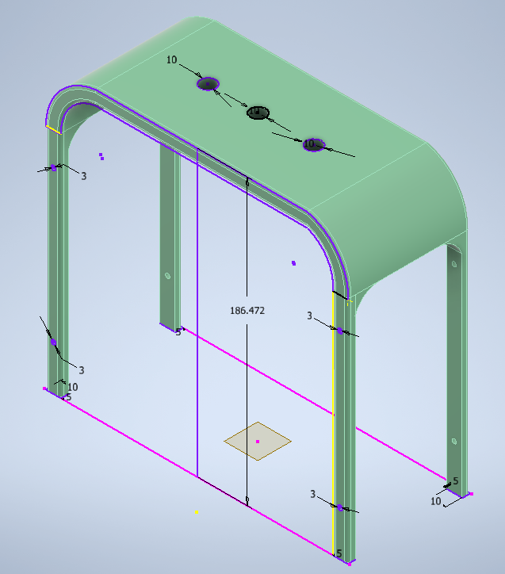
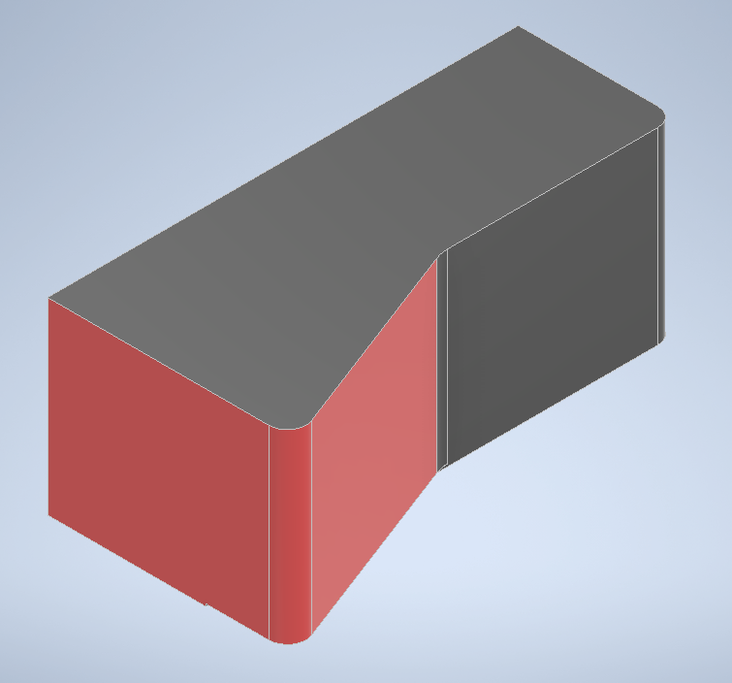
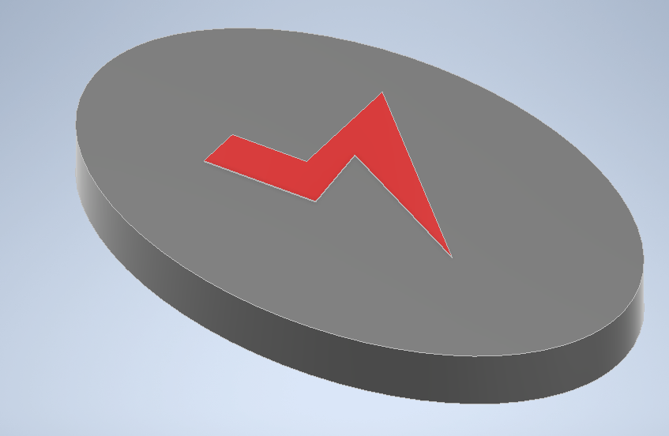
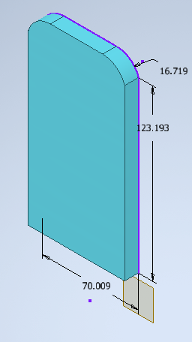
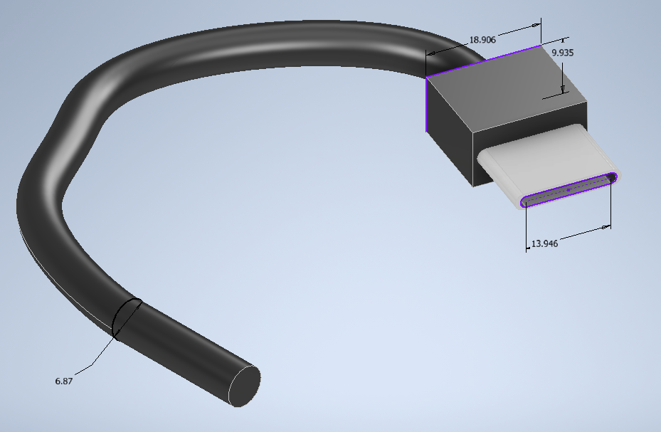
Task 4 – Use Of Computer Aided Design (CAD) – Assembly Of Parts
R039: TASK 4: 3D CAD
The finished design would be vacuum formed from ABS (a thermoplastic) as it has a low shrinkage of <1%, and offers high strength and low weight. Each element would be made in bulk then assembled together using screws as a mechanical fixing.

Slide 15
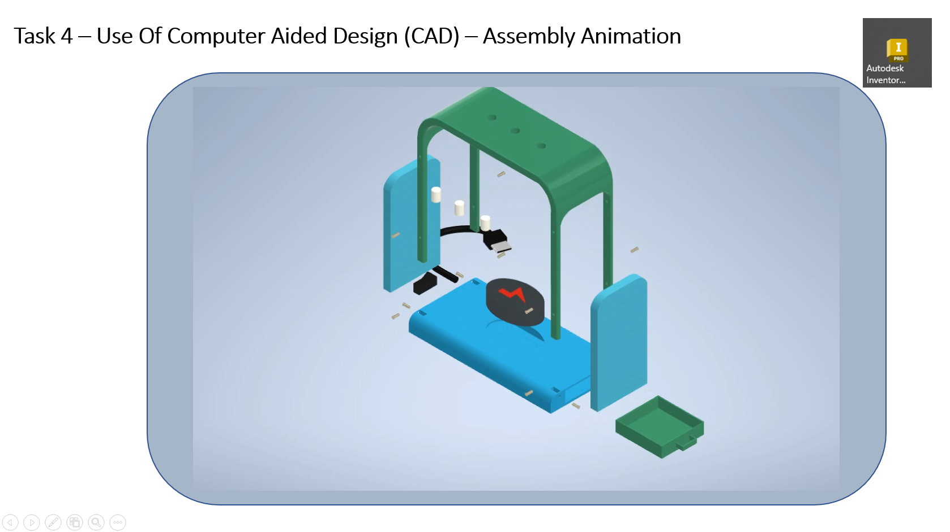
R039: TASK 4: 3D CAD

Slide 16
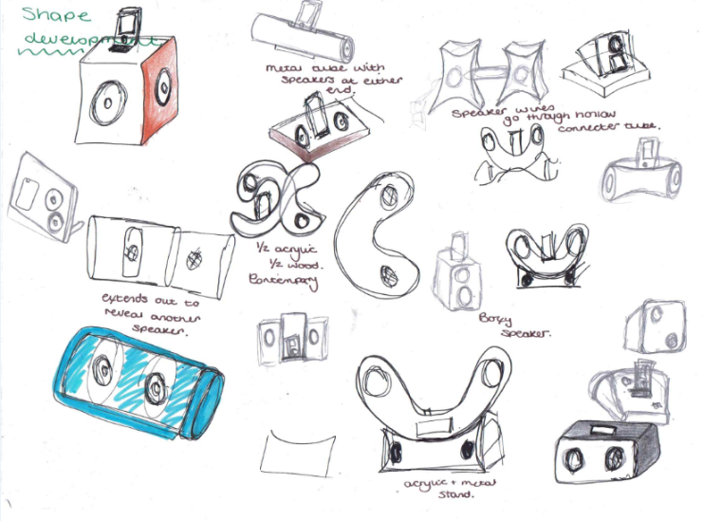
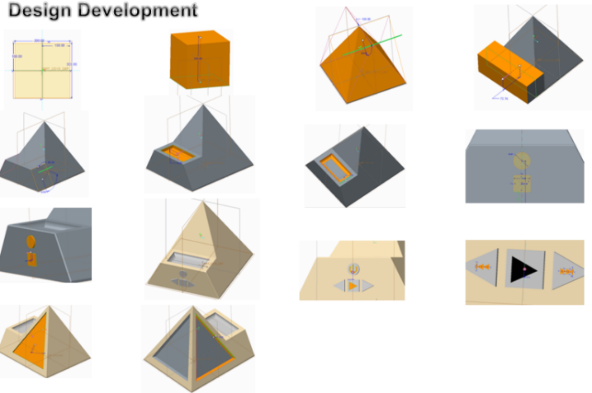
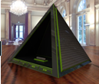
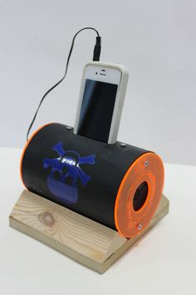
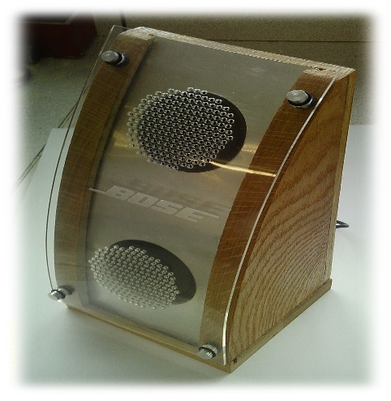
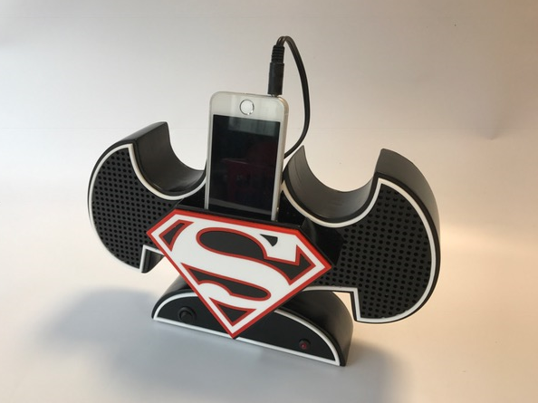
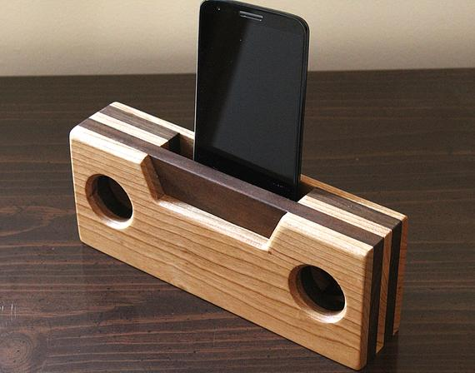
R039: Communicating Designs – Design portfolio produced on Powerpoint

Slide 17
Design Engineering (OCR Cambridge National) Level 2
R040: Design evaluation & modelling – Portfolio on Powerpoint
Primary & secondary analysis of a product
Product disassembly
Model a product made from several parts

Slide 18
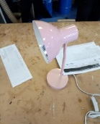
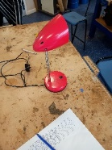
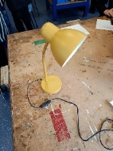
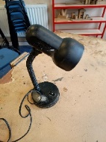
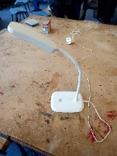
R040
Topic Area 1.1 Strengths & Weaknesses of Existing Products – Analysis of lamps from my Engineering Matrix
Image analysed from Engineering Matrix | Analysis of Strengths from score on Matrix | Analysis of Weaknesses from score on Matrix | Summary
 | This lamp is very aesthetically pleasing and would most likely target young girls for reading etc. I can see this from its simple design and pink colouring which generally appeals to a young female demographic. It had good balance and simple power source. It was made from metal which is generally a good material to recycle. | This design did not have an LED strip, but a bulb. This would bring down the desirability. By using bulbs the lamp is not economically suitable. Although there is a power source, it’s a plug which would limit the areas of use and limit it to not being portable. | Overall the lamp checks most of the boxes in terms of requirements. The main issue is the lack of an LED strip.
 | From my engineering matrix I discovered this lamp has a good power source and the colour is ok. Its made from metal which means it should be recyclable. It has a switch on the cord for easy access too. | I personally think this lamp is extremely lacking in the design. Its not a desirable shape and colour which makes it not aesthetically pleasing. This would also limit the target audience. This lamp also doesn’t have an LED strip included and uses bulbs. The stem is not flexible which limits its capabilities | Over all I think this lamp doesn’t check enough of the boxes required and could be redesigned to target a wider range of audiences
 | The lamp is beautiful in design and the colour is complimentary to this. The power source is good and has an easy access switch very close the base. Due to the metal kts made from t should be recyclable. This could target a wide audience and sell well. From my engineering matrix I identified that this lamp scored well in aesthetically pleasing. | However it doesn’t have an LED light but a bulb instead. It could comfortably stand on its own and stay in position. The base did not have a foam protective layer and could scratch surfaces beneath it. From my engineering matrix the lamp scored badly in mass production. | Over all this is a good lamp and except for the scratch base it’s a successful design. It can reach a wide audience and has a simple yet effective power source. Perfect for indoor use
 | This lamp has a very simple and classic design and has a good power source. It does have a flexible stem for different angles. The colour is very versatile and can fit many people styles which makes it a desirable colour and design. The switch it also on the base for convenience. | However it had poor balance and aesthetically its not very pleasing. The head is unproportionally long and ugly. Its also made of plastic which means its not recyclable materials. This lamp does not have an LED light in it bringing this down. This lamp scored worst in stability and aesthetics | Overall I think this design is not desirable and could use some modifying but the features are useful and would work well e.g. the switch being on the base is very convenient
 | This design is classic and would be valuable to many customers. The power source was good and a switch on the base for easy access. This lamp featured a flexible stem. From my engineering matrix this lamp scored the best aesthetically and also in LED capability | This lamp is made of plastic meaning it cant be recycled. The base was very light and small which means it could easily fall over if knocked. From my engineering matrix this lamp scored badly in access to power source due to a short lead. | Overall this is a successful design and it has an LED light feature. It wont scratch the surface its on. It could reach a wide target audience due to the simple aesthetic

Slide 19
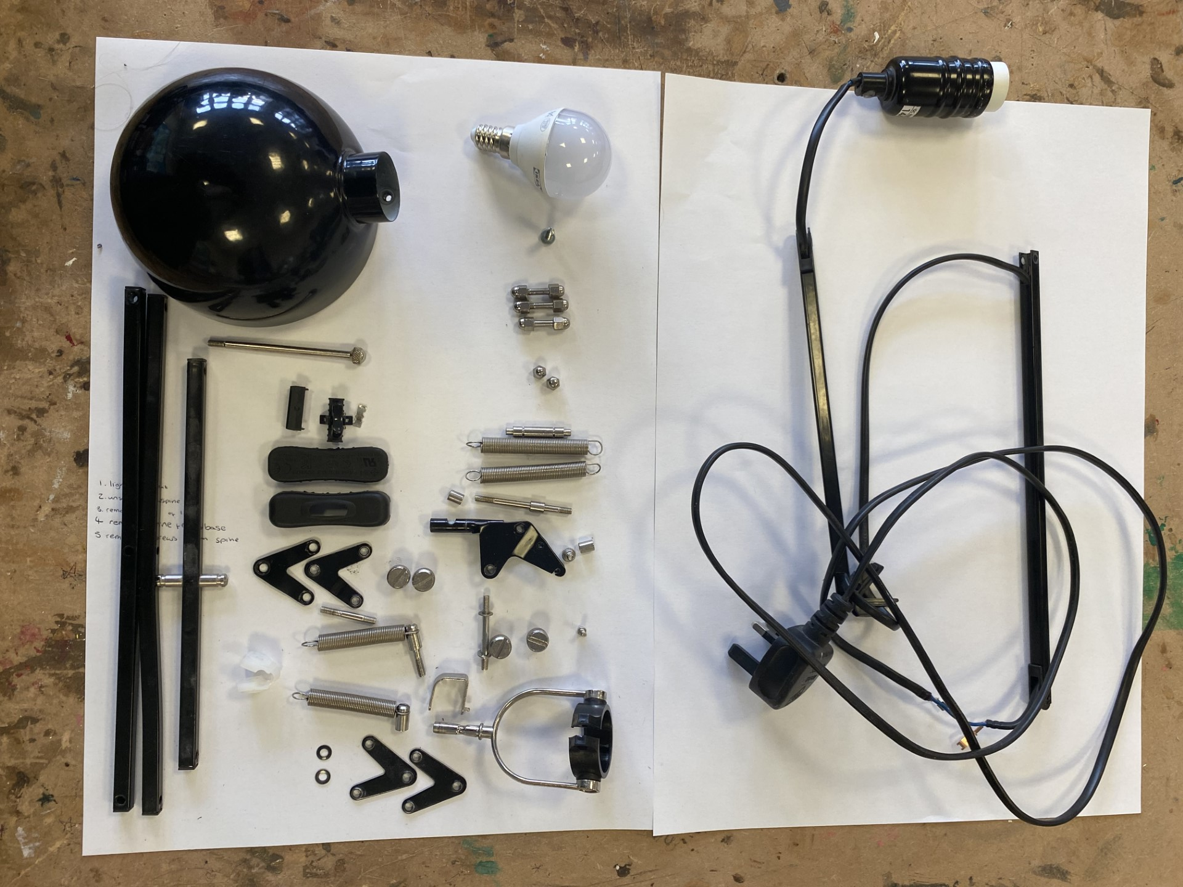

Design Engineering (OCR Cambridge National) Level 2
Light bulb
Screw for light bulb
Lamp cover
Cord
Light switch cover
Bolts
Parts of spine
Plug
Springs
Spine connective

Slide 20









Virtual 3d cad
R040 CAD modelling
First I created a right angle on a work plane with the correct dimensions.
Then I added another line at the front and a hypotenuse to form a quadrilateral.
Then I extruded the shape at 100mm to create a 3d shape

Slide 21
Design Engineering (OCR Cambridge National) Level 2
Risk assessment
Process tool | Description of process | Who might be harmed and how? | What are you doing to control the risks | What further action do you need to take control of risks | Who needs to carry out the action?
Laser cutting prototype | Design and make laser cut prototype to get idea for form & proportion | Strangulation from lose clothing, could be abrasive and hair could get caught | Stay within the boundaries. Wear goggles and apron | Tape boundary on the floor | Employer and operator
Line bending | A heated element used to shape materials | Could burn someone (1st or 2nd degree) as its not covered by any protection + inhalation. Can get cuts and burns. Could catch fire when heating plastic. Harmful fumes | Relevant signage close by. Fact sheets on desk next to it on how to use it. Safety glasses. Placed in well ventilated area | Make sure when using there is nothing around to distract the user in case of slipping | Employer and operator
Cut head piece with tenon saw & belt sander | Saw is used by hand The belt sander is a moving element to remove material slowly | Sharp edge can easily cut someone when not being careful (user) Dust inhalation and risk of the belt tearing (hitting you) and abrasions | Boundary area. PPE. Extraction unit. Emergency stop button close by. Safety glasses. Checked weekly. Floor boundaries | Make sure there is a clear brief on the machine Tape boundary on the floor to keep other from getting hurt and add an emergency stop button | Employer and operator
Cutting and gluing step shape for former | Sawing done by hand using a back and fourth motion | Sharp edge can easily cut someone when not being careful (user) | Wearing goggles and an apron to protect from getting glue in users eyes or on clothes. | When using a quick clamp point the handle to the inside of the table to avoid anyone bumping into it | Employer and operator

Slide 22








R040Practical processes
Then we glued these pieces together and held them together with a clamp (facing into the table for health and safety) in the vice.
clamp
Tri - square
Once all the pieces of wood were glued together I had to take the staircase structure to the belt sander to make a smooth slope. When using the belt sander I wore goggles and an apron for health and safety.
When using the sander I had to move the piece back and forth so that the sander has used equally across the surface. This avoids the sand belt from being weaker is some areas.

Slide 23






Improvements
R040 Practical & Evaluation
Task 6 TA2 Physical Modelling Evaluation of Prototype
You can take this apart for maintenance or recycling however the pieces glued together cannot be taken apart and out it back together for maintenance showing room for improvement
Sanding belt to shape the head piece and the base former
I used a ruler, a pencil and a tri square to measure and mark out on my wood former
Used a drill for the hole in the stem piece. Arguably this hole is quiet small as its part of the access to power source
Spray painted head piece
No LED strip
When vacuum forming in a well ventilated area, I used an accurate timer so that the plastic didn’t melt or catch fire
The base is quite small in comparison to the head this effects the aesthetics of the prototype.
Line bent stem ( used protractor to measure angle. If this were to be mass produced it would be better to use a jig) we wore goggles but didn’t use gloves due to loss of mobility.
We used a hegna saw to remove excess plastic from base. This also means that the base will easily scratch surfaces due to rough edges. vacuum forming the base piece is also suitable for mass production due to vacuum forming
Is free standing but its also leaning due to heavy head piece

Slide 24










Engineering Employers to name a few…

Slide 25
What job could Engineering lead onto? …to name a few
Creative industry
Theatre/Set Designer
Television Production
Visual Communication
Graphic Designer
Web Design
Games Design
App Design
Illustrator
Advertising
Garden design
Civic design/Town planner
The list goes on….
Product Designer
Product Engineer
Architect
Entrepreneur
Engineer electrical/mechanical
Materials science
Manufacturing
CAD Designer/ CAD Engineer
Quality assurance/Quality controller
Construction industry all levels
Television/media Engineer
Traditional trades

