Slide 1

Year 9 Options 2026-2028
Geography
“The study of geography is about more than just memorizing places on a map. It’s about understanding the complexity of our world, appreciating the diversity of cultures that exists across continents. And in the end, it’s about using all that knowledge to help bridge divides and bring people together.”
President Barack Obama, 2012
‘Inspiring hearts and minds with Christ at the centre of all we say and do’

Slide 2

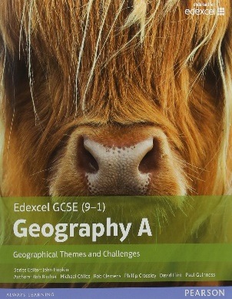


Course and Qualification Information
Qualification details
Students will gain a single-award GCSE in Geography, studying the Edexcel exam board’s GCSE (9-1) Geography A (1GA0).
What does the course cover?
Within the specification there are two sections concentrating on the interaction between Human and Physical Geography.
1. The Physical Environment (Rivers, Coasts, Weather Hazards and Ecosystems)
2. The Human Environment (Changing cities, Global Development and Resource Management)
Students will complete various fieldwork investigations to enhance and develop their knowledge and understanding in the necessary skills required for their GCSE.
‘Inspiring hearts and minds with Christ at the centre of all we say and do’

Slide 3
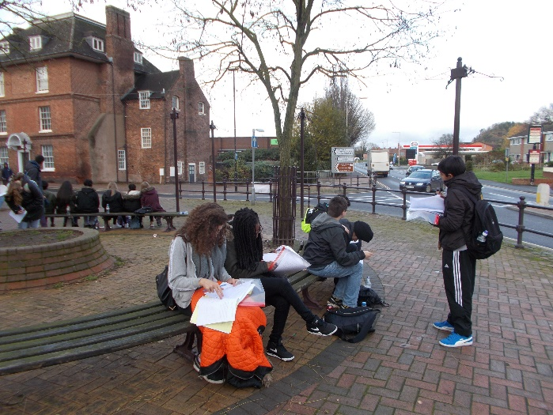
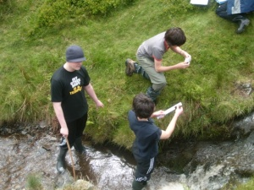
Assessment Information
How is the course assessed?
1. The Physical Environment - written examination 37.5% of qualification
2. The Human Environment - written examination 37.5% of qualification
3. Geographical Investigations externally assessed written exam 25 % of qualification
Types of question on the exam.
Multiple-choice questions, short open response questions, calculations and extended writing.
Marks are also awarded for spelling, punctuation, grammar and use of specialist terminology.
‘Inspiring hearts and minds with Christ at the centre of all we say and do’

Slide 4


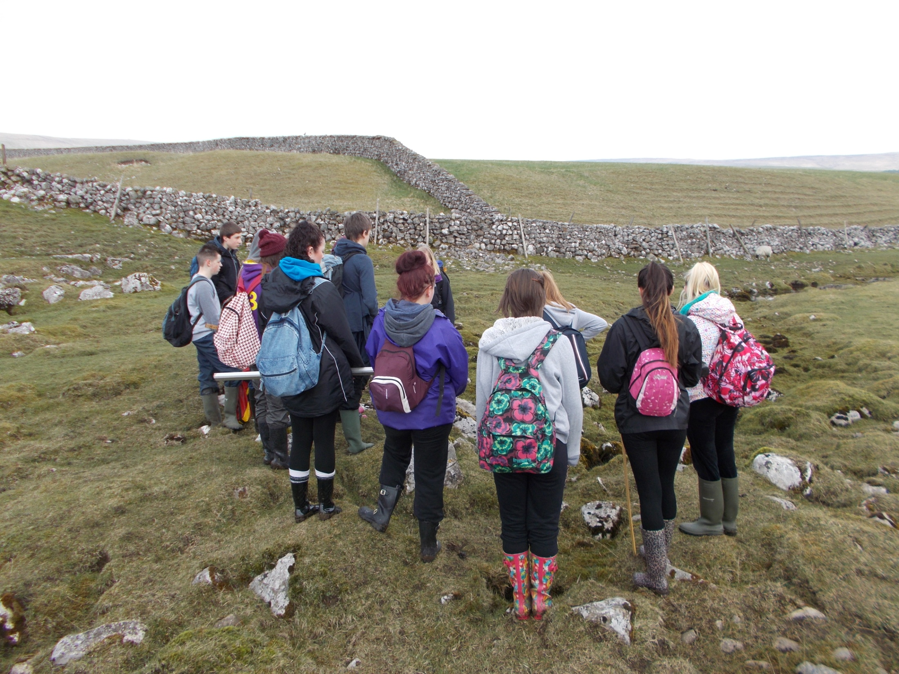
Extra Curricular Opportunities
Whilst studying Geography students will have the opportunity to be involved with the following extra curricular groups
Fair trade Group – understanding the role we have in reducing exploitation of our planet’s resources and fair trade for all.
Weather watchers – observing and recording daily weather, analysing data and using weather instruments.
Environmental Group – understanding the current crisis faced by Planet Earth and campaigning and encouraging for change.
Residential – a week conducting fieldwork in areas beyond the West Midlands to greater understand the Physical and Human Geography of the UK
‘Inspiring hearts and minds with Christ at the centre of all we say and do’

Slide 5

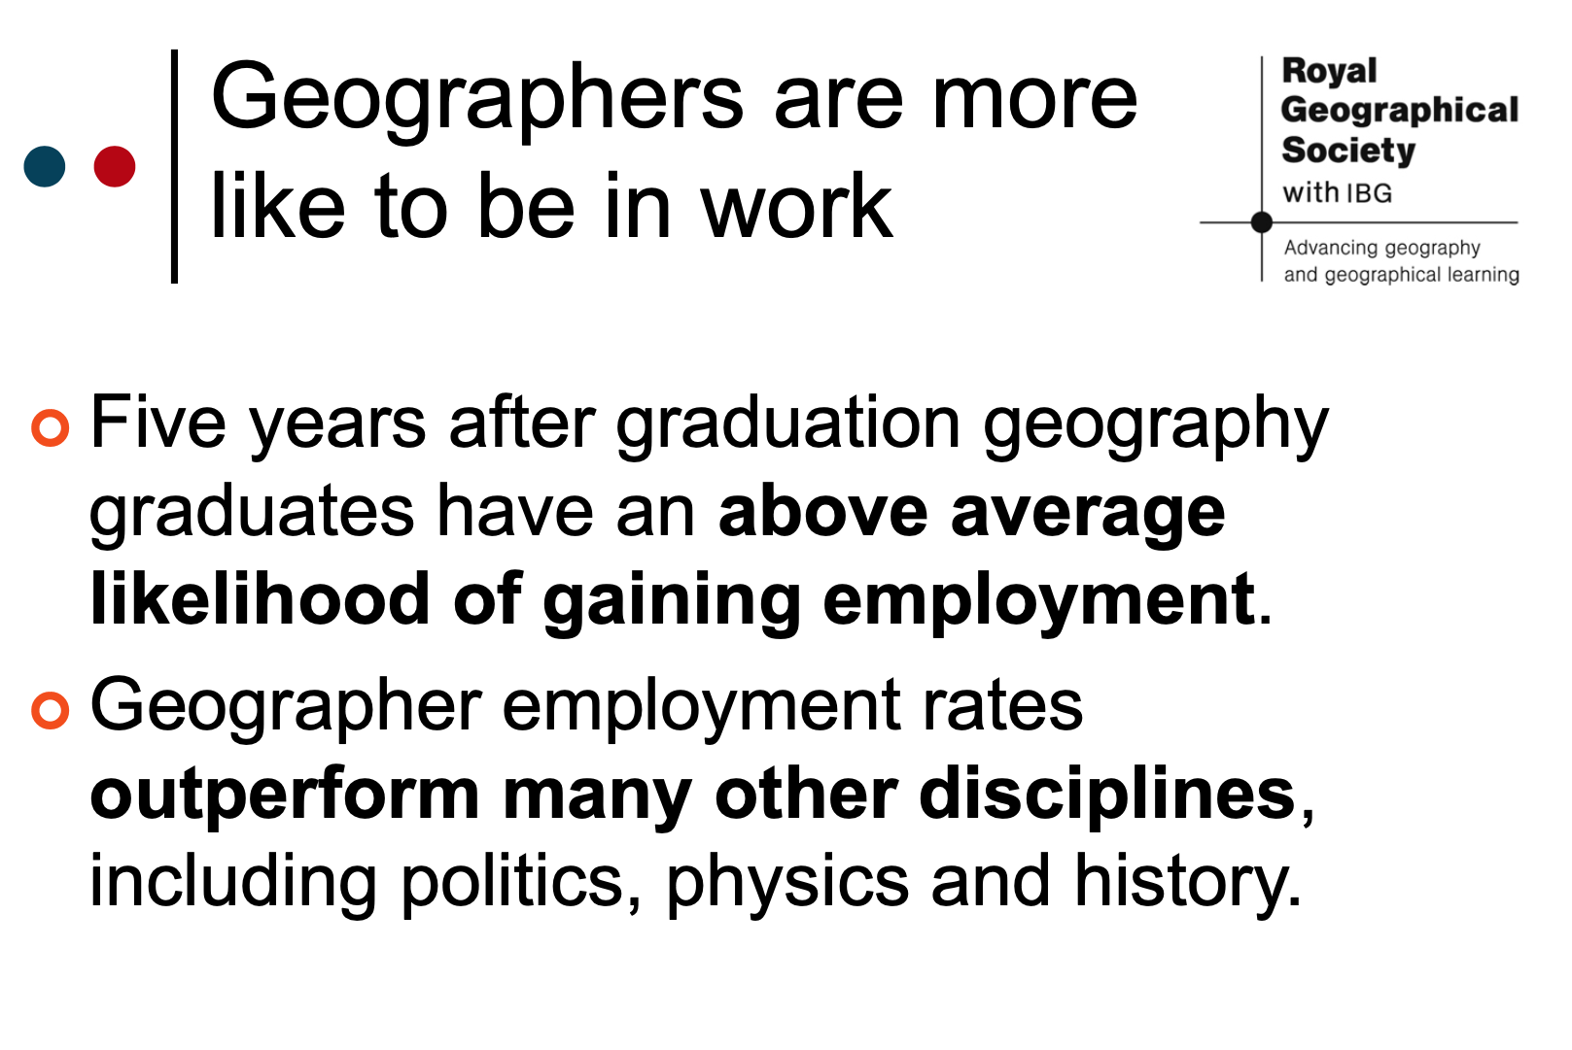
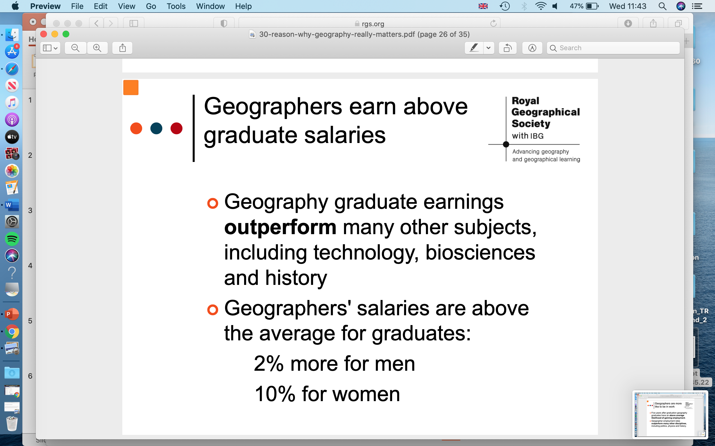
Next Steps and Career Pathways
Compared to other subjects, Geography students are among the most employable. They possess the skills employers are looking for.
Geographers are:- Geographers learn how to:-
Good communicators Write concise reports
Spatially aware Handle data
Problem solvers Ask questions
Work as part of a team Make decisions
Computer literate Analyse information
Flexible thinkers Organise themselves
Think creatively
‘Inspiring hearts and minds with Christ at the centre of all we say and do’

Slide 6
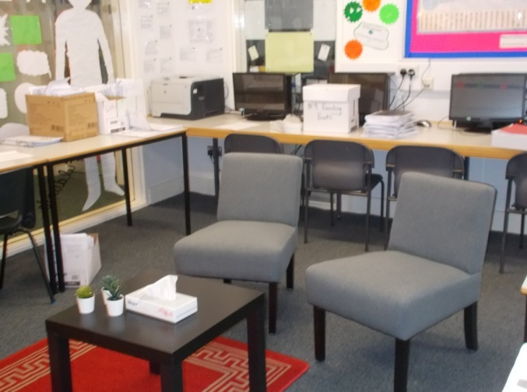
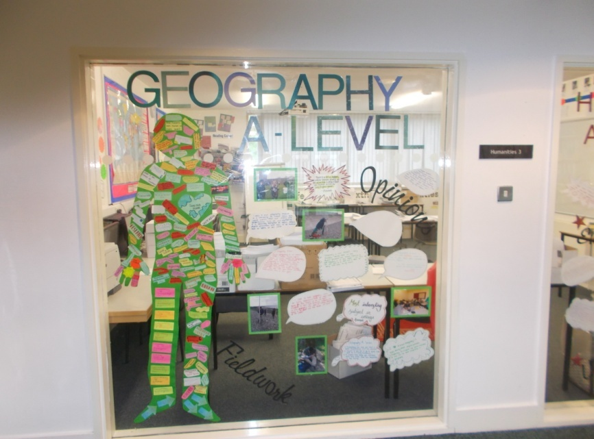
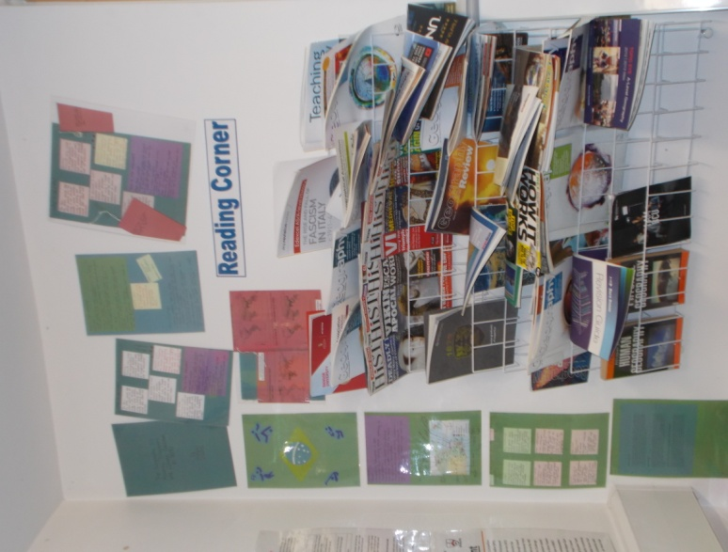
Additional Information and Outcomes
The department also offers
A Humanities Study Hub – a separate room for access to Geographical resources and IT equipment
Sixth Form Mentoring Programme – one to one coaching from learners who have already completed GCSE Geography.
Careers vocational focus / opportunities – incorporated throughout the course to teach the links between theoretical study and the world of work e.g. weather forecasting, water management, architecture and land use planning.
Exam preparation – department
produced revision resources, online
help and teaching, after college
revision classes and regular
assessment practise.
‘Inspiring hearts and minds with Christ at the centre of all we say and do’

Slide 7
Frequently Asked Questions
What Teacher will my son or daughter have at GCSE?
All department staff deliver GCSE Geography so you could be taught by any of the department staff, however, we do try to keep to the same teacher as KS3 where possible, to help with a smooth transition into KS4.
Can I study Geography and History?
Yes, we have many students who study Geography and History as they appear in different option blocks, and both subjects help develop transferable skills which complement each subject.
Will I have to write long essays?
No, Geography is not an essay subject, and Geography GCSE is about writing in a concise way.
Are there any key resources that I should buy to support my child taking this subject?
This revision guide is useful to use at home published by Pearson for Edexcel specification A
What can you do with GCSE Geography?
Employers and universities see Geography as a robust academic subject rich in skills, knowledge and understanding. As a subject linking the arts and the sciences it is highly flexible in terms of what you can combine it with, both at GCSE and A Level. If you choose to take geography on to university there are literally hundreds of courses to choose from and the range of career areas accessed by graduates of Geography will probably surprise you. Careers and jobs can include (but are not limited to) journalism, environmental consultancy, international development, planning and sustainable energy
‘Inspiring hearts and minds with Christ at the centre of all we say and do’

