Slide 1


Year 9 Options 2026-2028
Enterprise
and Marketing
‘Inspiring hearts and minds with Christ at the centre of all we say and do’

Slide 2
Course and Qualification Information
Cambridge National in Enterprise and Marketing
Cambridge Nationals are vocational qualifications at Level 1/2 for students aged 14–16.
An aspiration for many young people is to be self-employed and start their own business. The skills required for this, such as being able to work collaboratively and creatively, solve problems and have awareness of businesses and customers, are also those requested by employers.
The qualification allows students to get to grips with key aspects of running small businesses with a focus on enterprise and marketing.
All learners will study three compulsory units:
• Enterprise and marketing concepts - Unit 1 – exam – Year 11
• Design a business proposal - Unit 2 – coursework – Year 10
• Market and pitch a business proposal - Unit 3 – coursework – Year 11
‘Inspiring hearts and minds with Christ at the centre of all we say and do’

Slide 3
Assessment Information
Unit 1 – Year 11 – External exam – 1 hour and 30 minutes
Students will learn about the methods businesses use to understand their market and develop products, investigate what makes a product viable and understand how businesses attract customers. They will also learn about key aspects of small businesses, including ownership and departments.
Unit 2 – Year 10 – Internally assessed coursework
In unit 2, students are provided with a business challenge. From this they will create a researched and costed business proposal. Students will need to undertake activities such as conducting market research, presenting data, using idea generation tools, seeking and acting on feedback, and costing proposals.
Unit 3 – Year 11 – Internally assessed coursework
In unit 3, students will prepare for and pitch their own business from unit 2. Alongside developing a brand identity, students will investigate how to promote their product. After delivering their practice and professional pitch, they will review their own performance and business proposal.
‘Inspiring hearts and minds with Christ at the centre of all we say and do’

Slide 4

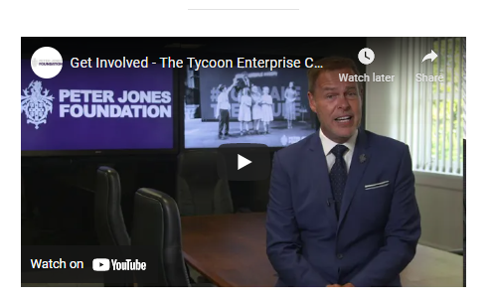
Extra Curricular Opportunities
Talks from managers in local businesses
Work Skills Enterprise Competition March 2027
Develop team working and communication skills
Develop presentation skills
Transferable skills for college/university
‘Inspiring hearts and minds with Christ at the centre of all we say and do’

Slide 5
Next Steps and Career Pathways
Cambridge Nationals provide a strong base for progression to further education, whether it is Level 3 BTECs, A Levels, apprenticeship or work.
Knowledge gained would be of use for further studies in other business and management qualifications including
retail, marketing and customer service. Through the study of three units, this course helps students to develop applied knowledge and practical skills in Enterprise and Marketing and is designed with both practical and theoretical elements, which will prepare students for further study of qualifications in Enterprise, Marketing, Business or Economics.
The course is useful for a wide range of careers, including management, finance, law, media, psychology, accountancy.
You will also know how to set up and run your own business!
‘Inspiring hearts and minds with Christ at the centre of all we say and do’

Slide 6
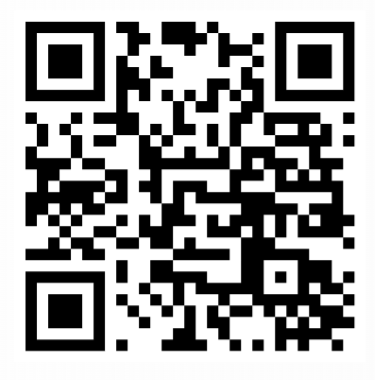
Additional Information and Outcomes
Cambridge Nationals are vocational qualifications at Level 1/2 for students aged 14–16. An aspiration for many young people is to be self-employed and start their own business. The skills required for this, such as being able to work in a team and creatively, solve problems and have an awareness of businesses and customers, are also those requested by employers.
Each unit is graded Pass, Merit or Distinction. Each grade is allocated points, and the total points students achieve determines their final grade.
The syllabus can be found using this QR code:
 | 2024 | 2025
Distinction*-Pass | 100% | 100%
Distinction* | 0% | 0%
Distinction | 12% | 0%
Merit | 36% | 43%
Pass | 52% | 57%
‘Inspiring hearts and minds with Christ at the centre of all we say and do’

Slide 7
Frequently Asked Questions
How many units do I have to do?
2 coursework units and 1 exam. In the first unit (year 10) students develop a product set by the exam board. In the second unit (year 11), students complete a pitch and marketing strategy for their previously designed product.
Do I have to do an exam?
Yes, it is taken at the end of Year 11. It is a 1 hour 30-minute written exam. A calculator is needed for some questions.
What do I do if I find the work difficult?
You will be given books & notes to help you complete the work. There are also plans to follow for your coursework.
Do I need to buy any textbooks/equipment?
You do not need to buy any textbooks. You will need a calculator for the exam in Year 11.
Will I pass?
Yes, if you complete the set work and follow the advice of Mr Cutler.
‘Inspiring hearts and minds with Christ at the centre of all we say and do’

