Slide 1

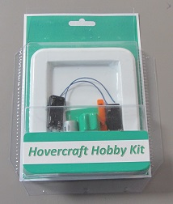
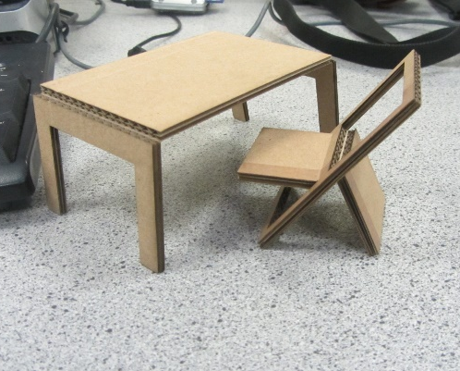
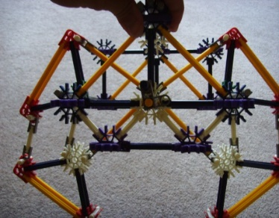
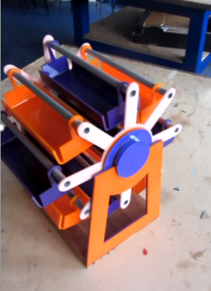
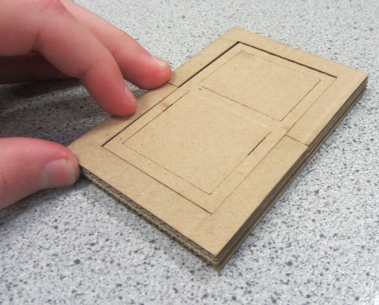
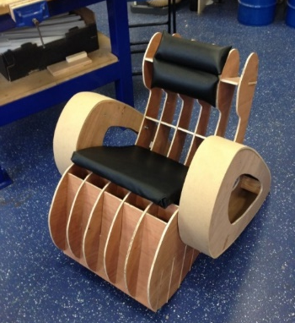
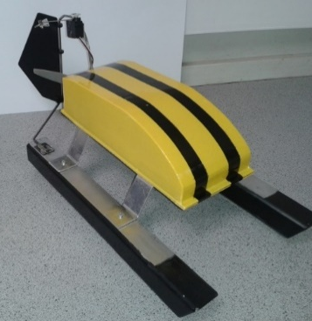
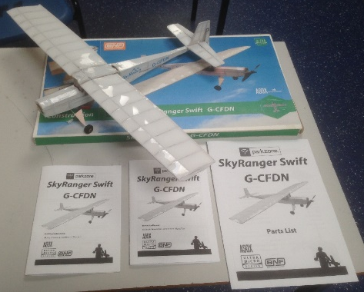
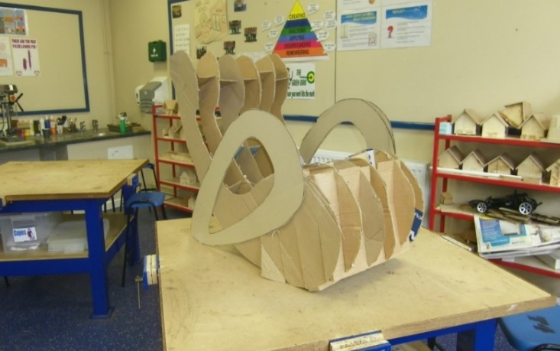
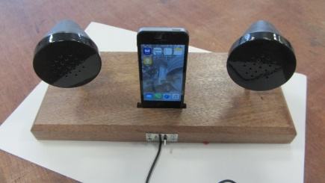
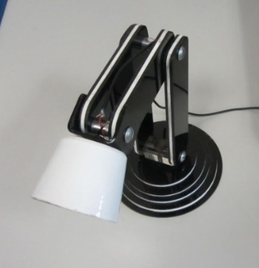
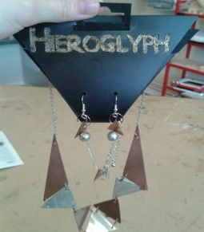
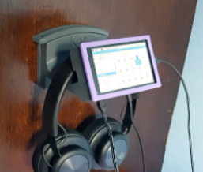
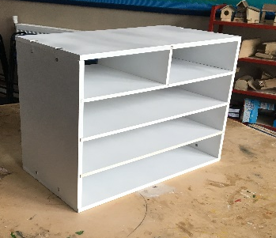
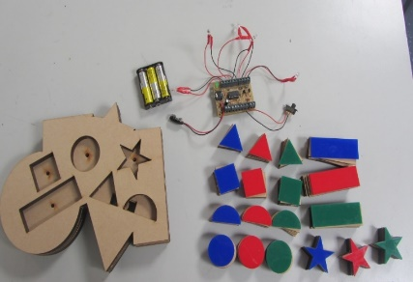
OCR GCSE Design & Technology
Why take Design & Technology? A short video

Slide 2

Who would be suited to this course? Is this for me..
Students who are interested in investigating an opportunity to design & make something new.
Imaginative students who like to create & innovate
Students that enjoy creating an electronic folder & evidencing their creative journey
Students who can be trusted to work independently
Students who enjoy following a process
Students who can’t be bothered with drawing/designing
Students who just want to make something
Students that don’t like writing
Students that would prefer being told what to make
Students who like to be directed

Slide 3
How is the course structured?
Students can use materials & including:
Graphical techniques/communication
CAD/CAM (laser cutting/3D printing/milling)
and physical prototyping materials
Wood/manufactured boards
Metals/alloys
Plastic/composites
Textiles
Electronics/systems/programming skills
New/Smart materials
Recycled materials
The GCSE Design & Technology Qualification is made up of :
50% coursework (30-35hrs)
50% exam (2hrs)

Slide 4
NEA (Non Examined Assessment) Powerpoint portfolio (roughly 25 slides)
The course simulates how design & manufacturing professionals work
Explore
Students explore a creative context, identifying a stakeholder, analyse relevant existing products/systems, to then create a technical specification
Create
Design thinking: Innovative and creative response to identified d problem using a range of creative design processes & iterations
Design Communication: Evidence Informal graphics & modelling skills and progression towards final prototype
Creation of prototype: Use of relevant materials based on properties identified during exploration & design phase.
Evaluate: Students evaluate throughout the design process based on stakeholder & user feedback. Students identify strengths & weaknesses & respond accordingly

Slide 5
Difference between KS3 & GCSE
Student given a design context, for example: Sports & fitness, Gardening, Urban living, Celebrations etc..
Student researches chosen area & identify a gap in the market or a chance to design & create a new product/system
Student identifies the customer & stakeholders and communicate with them throughout the design & make process, responding to what they want.
Student follows an iterative design process:
Iterative design process

Slide 6
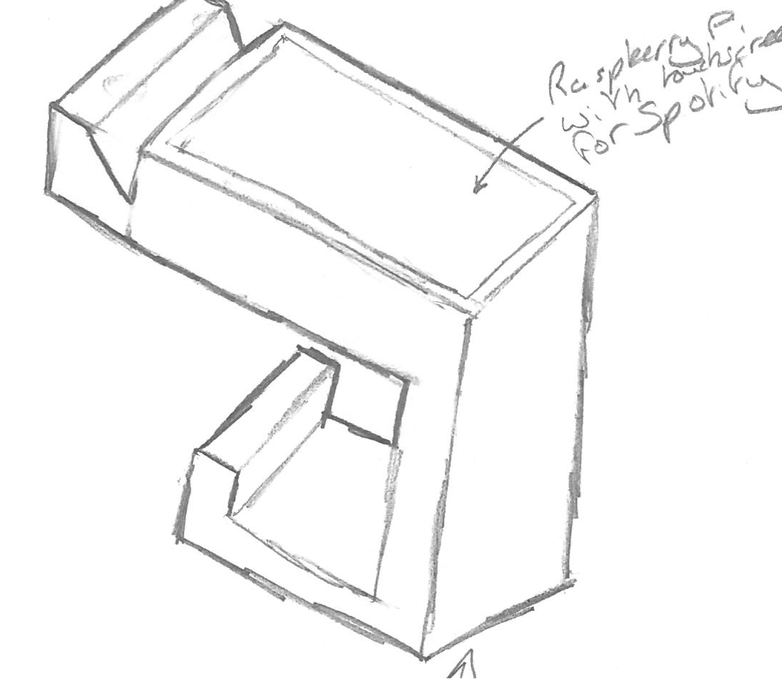
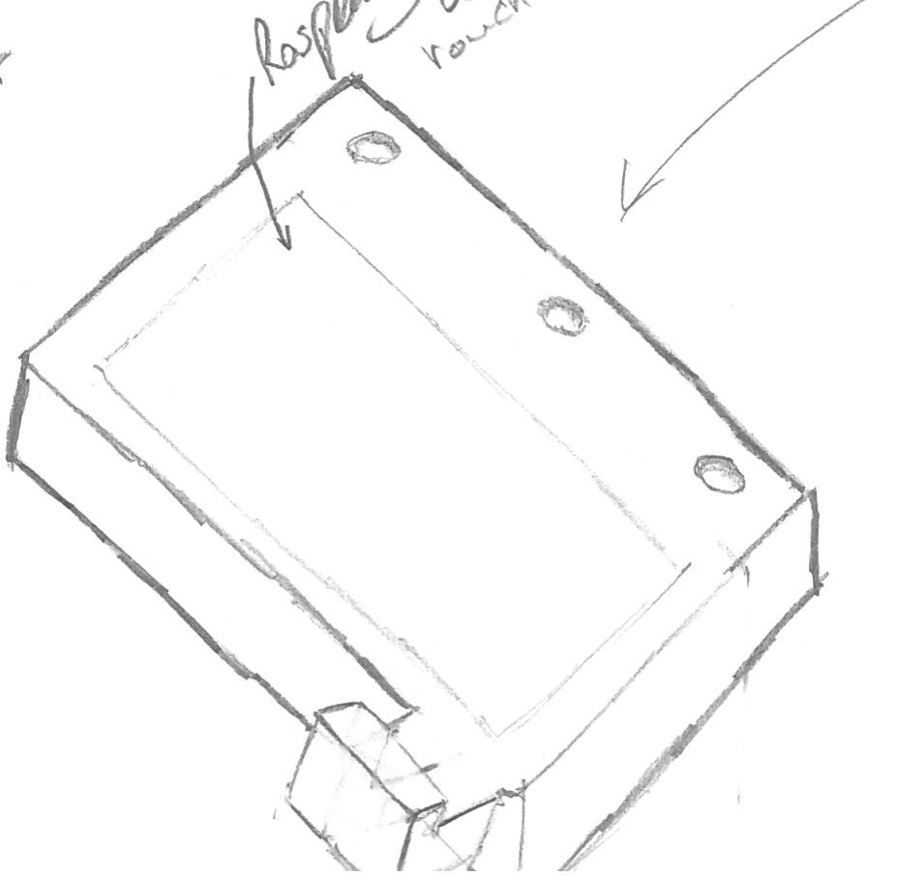
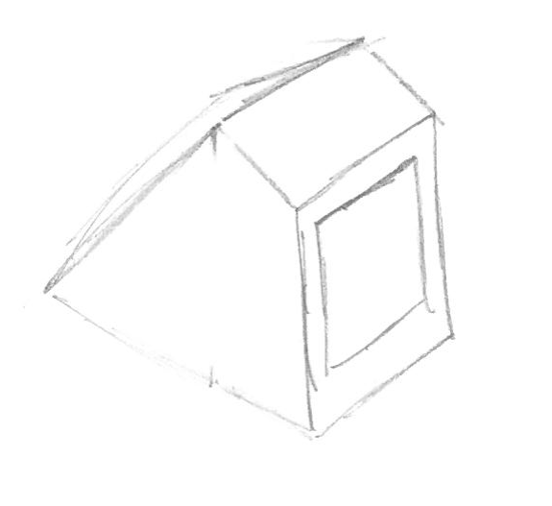
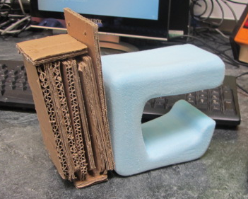
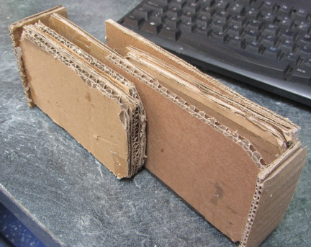
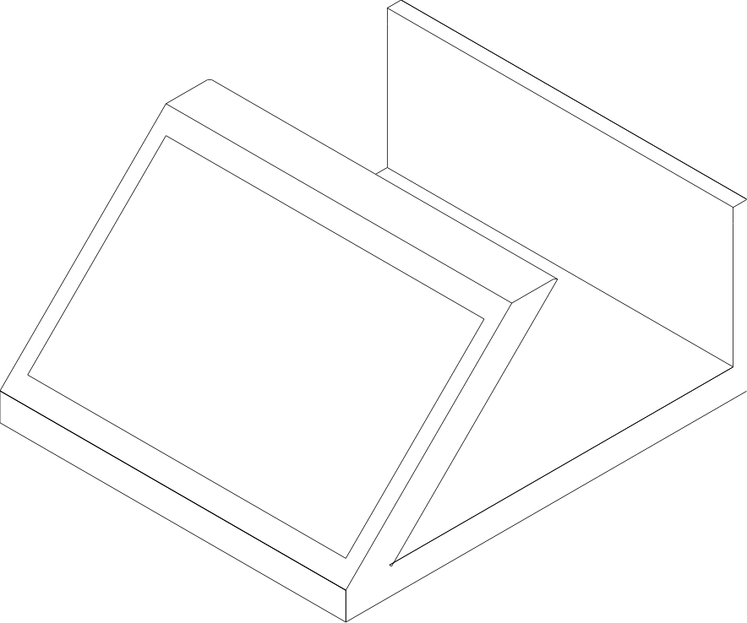
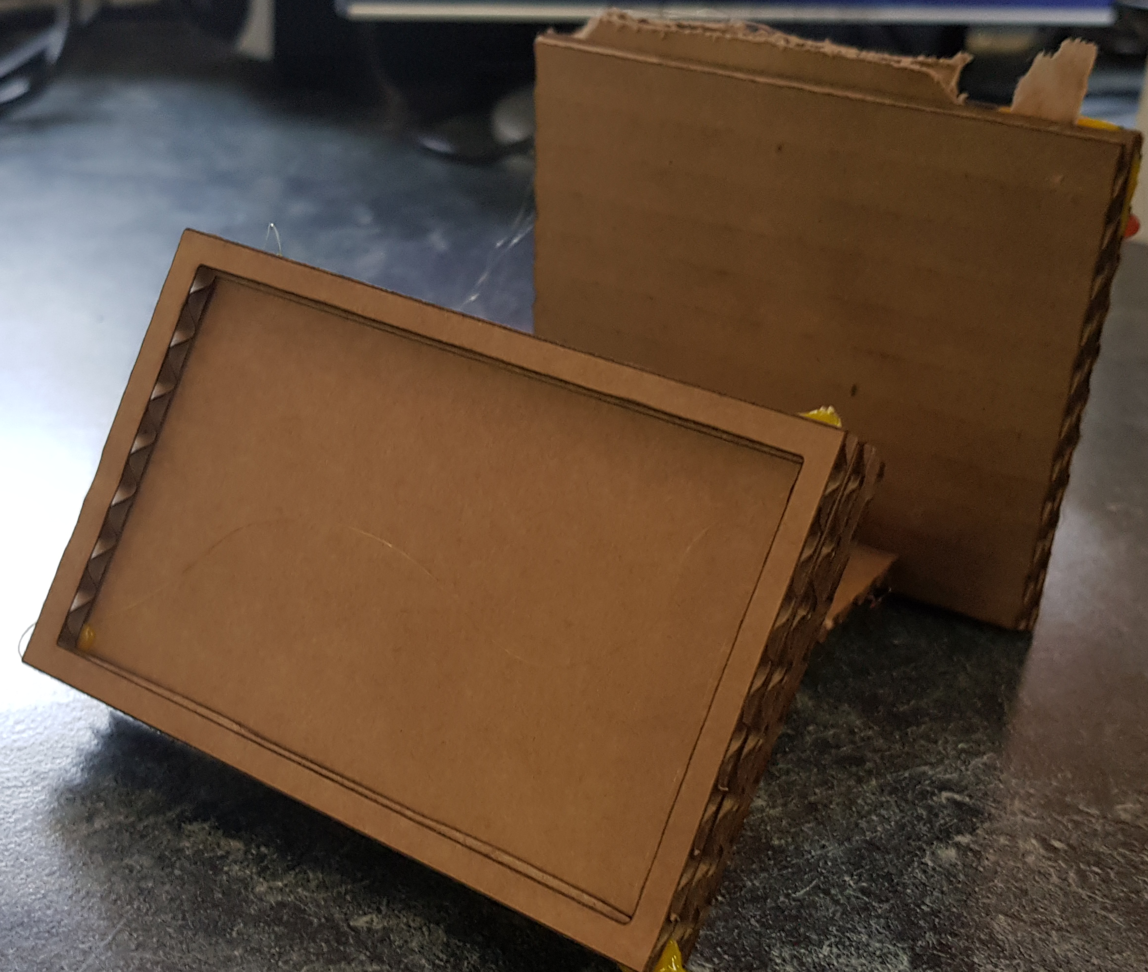
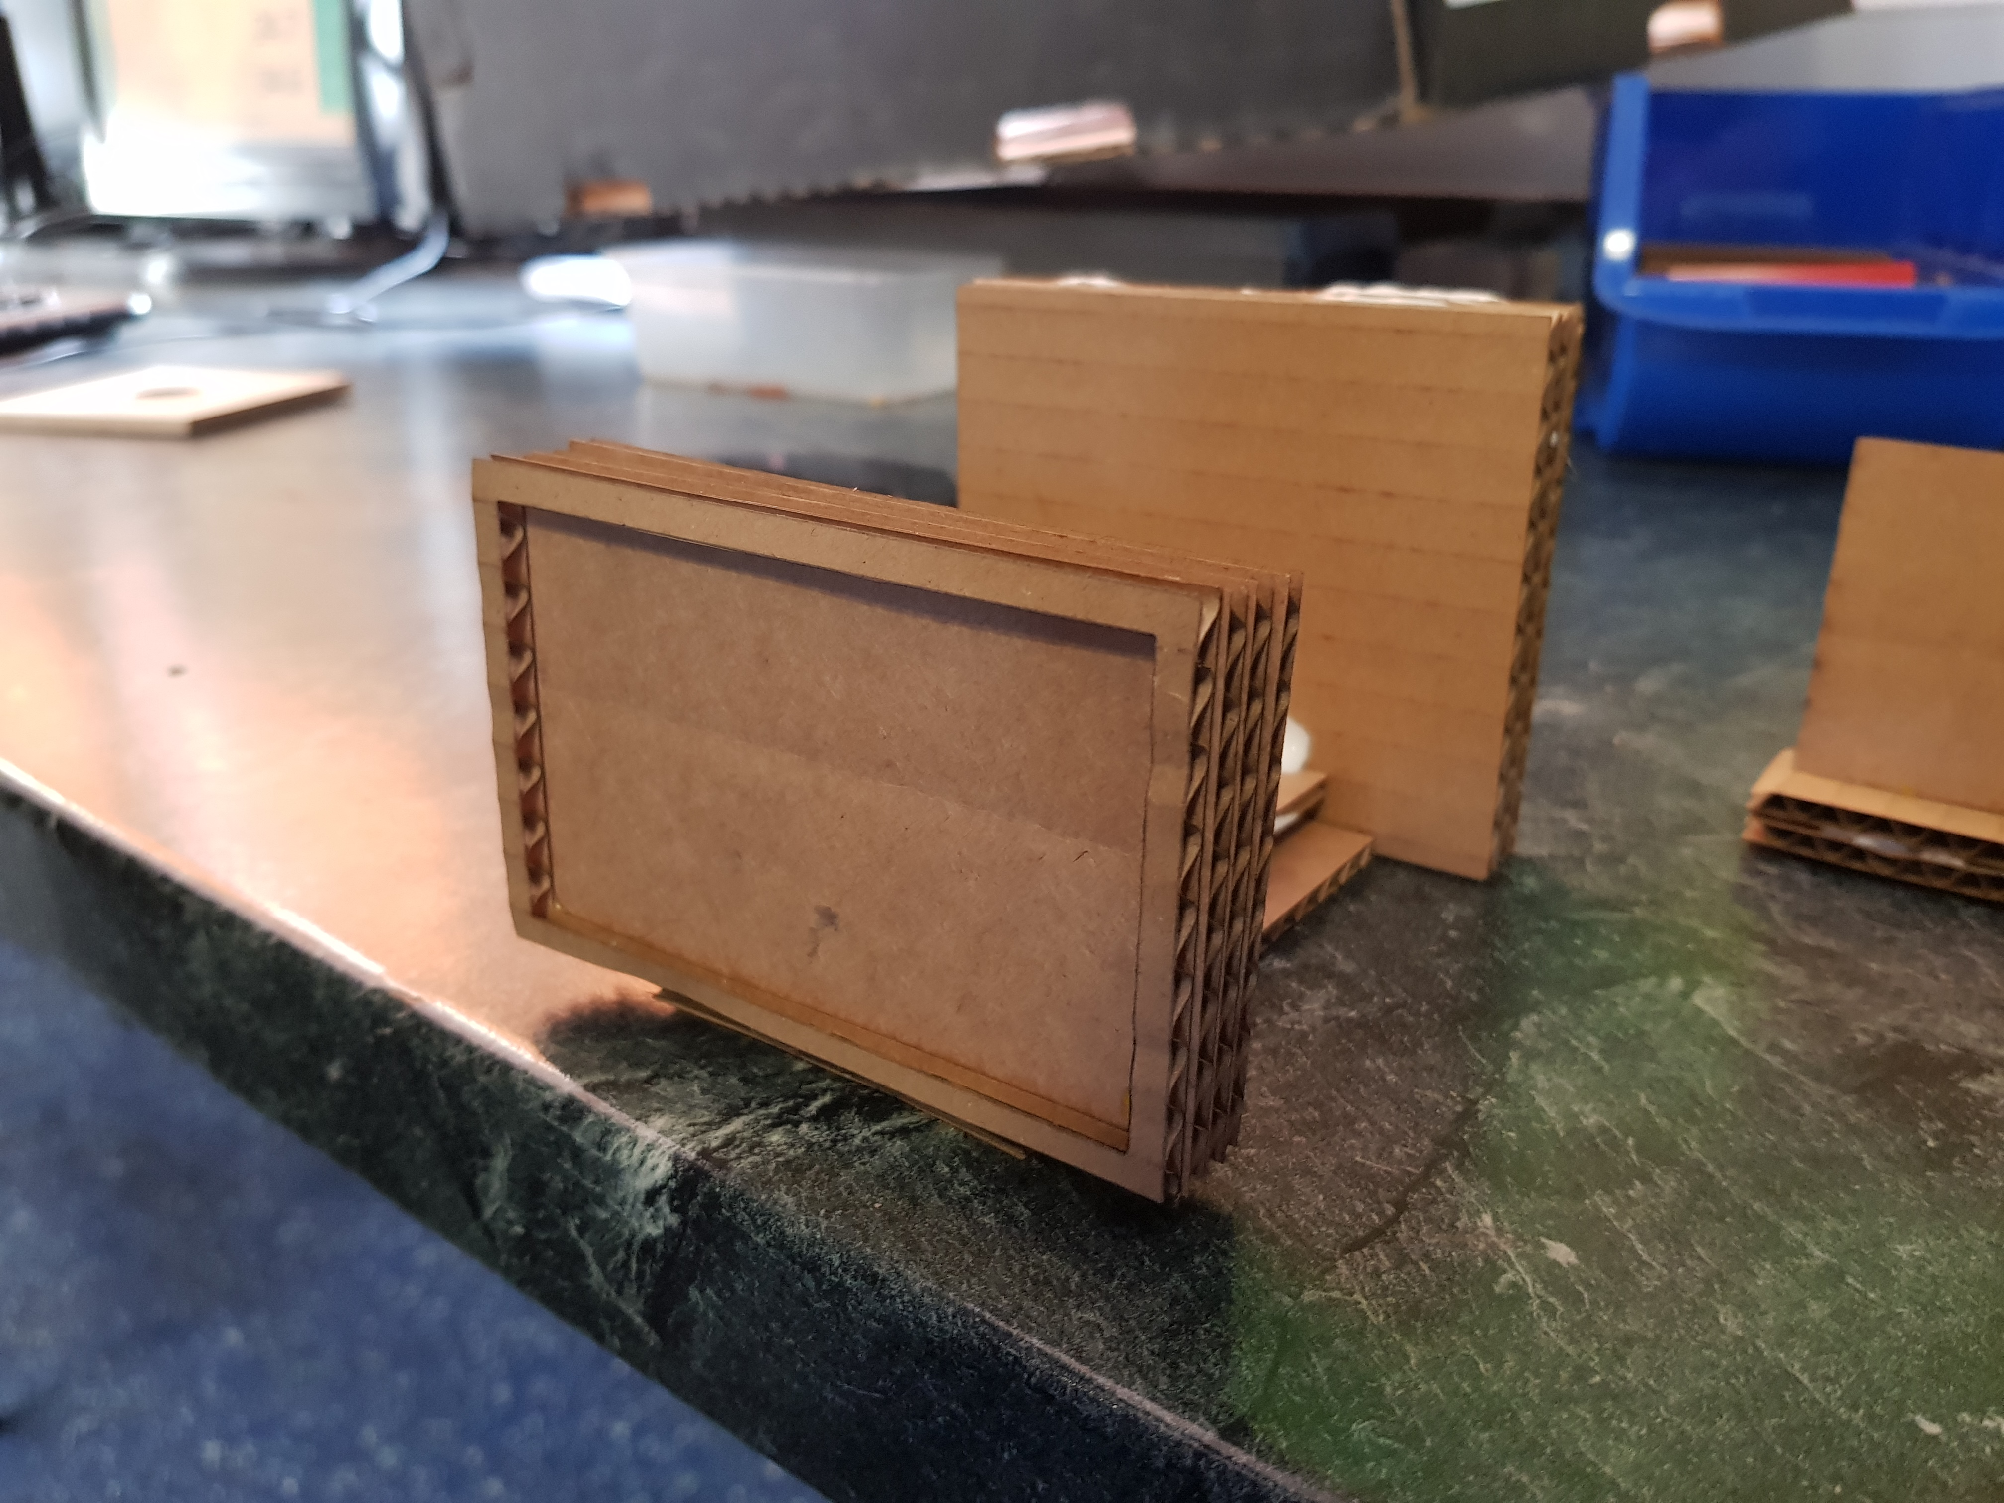
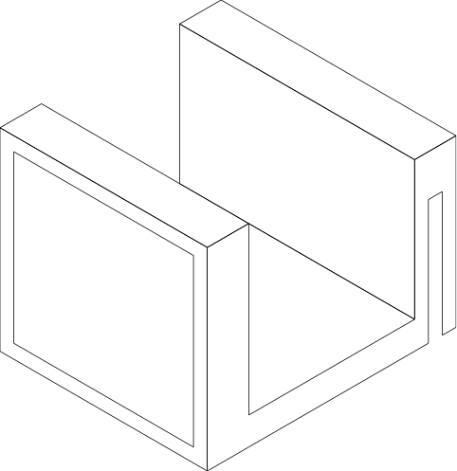
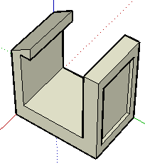
Project 1: Headphone stand with electronic interface prototyping. Iterative process

Slide 7
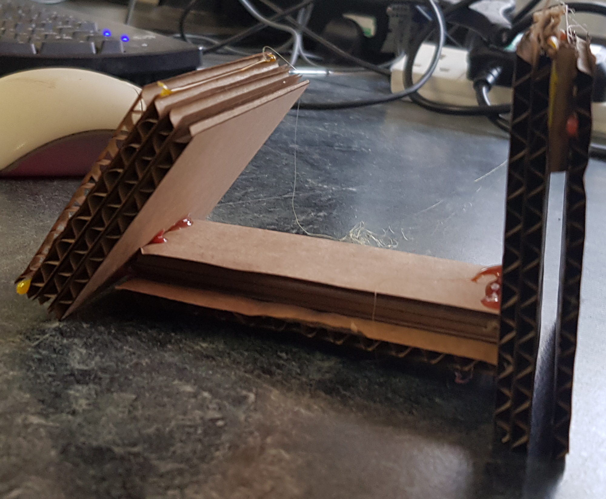
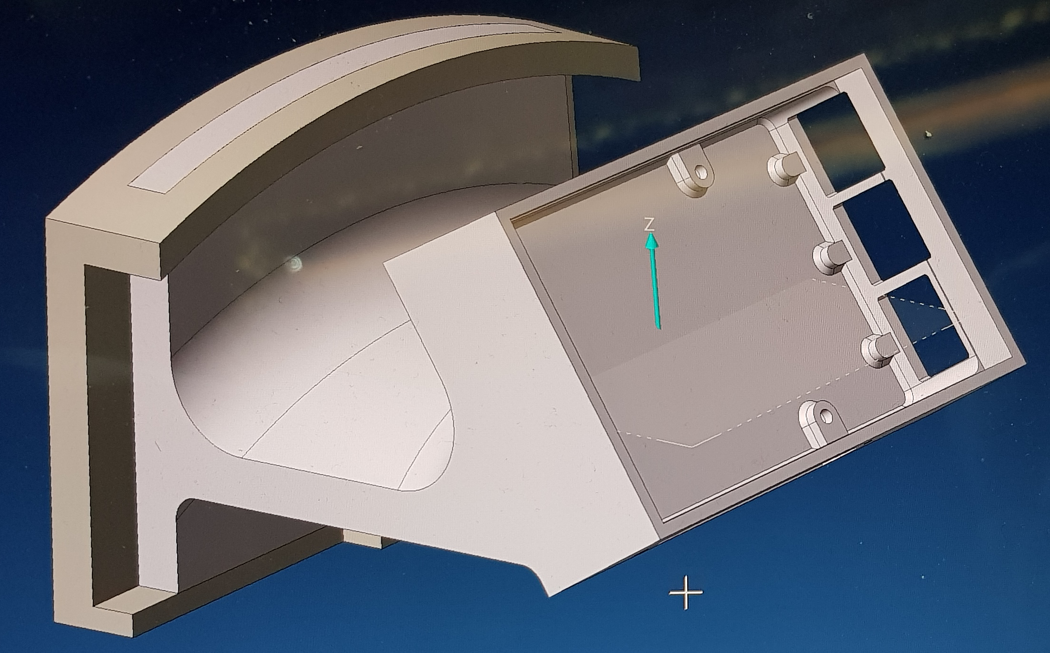
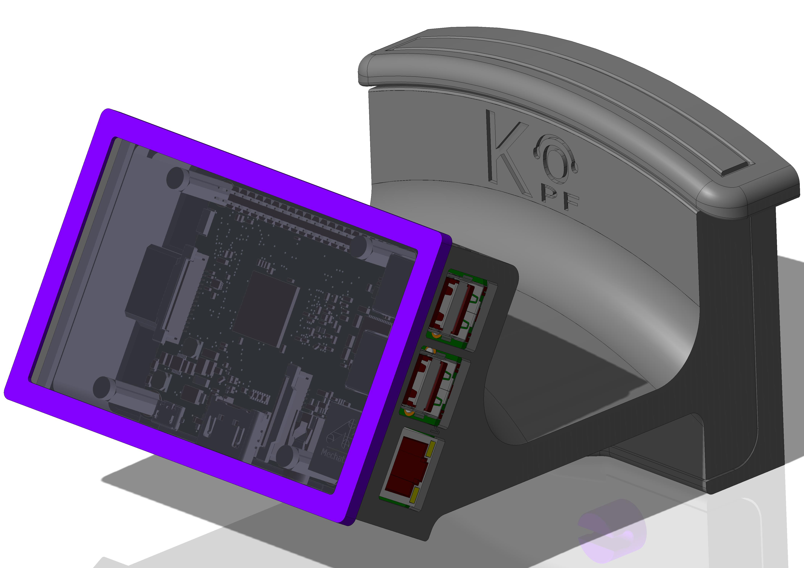
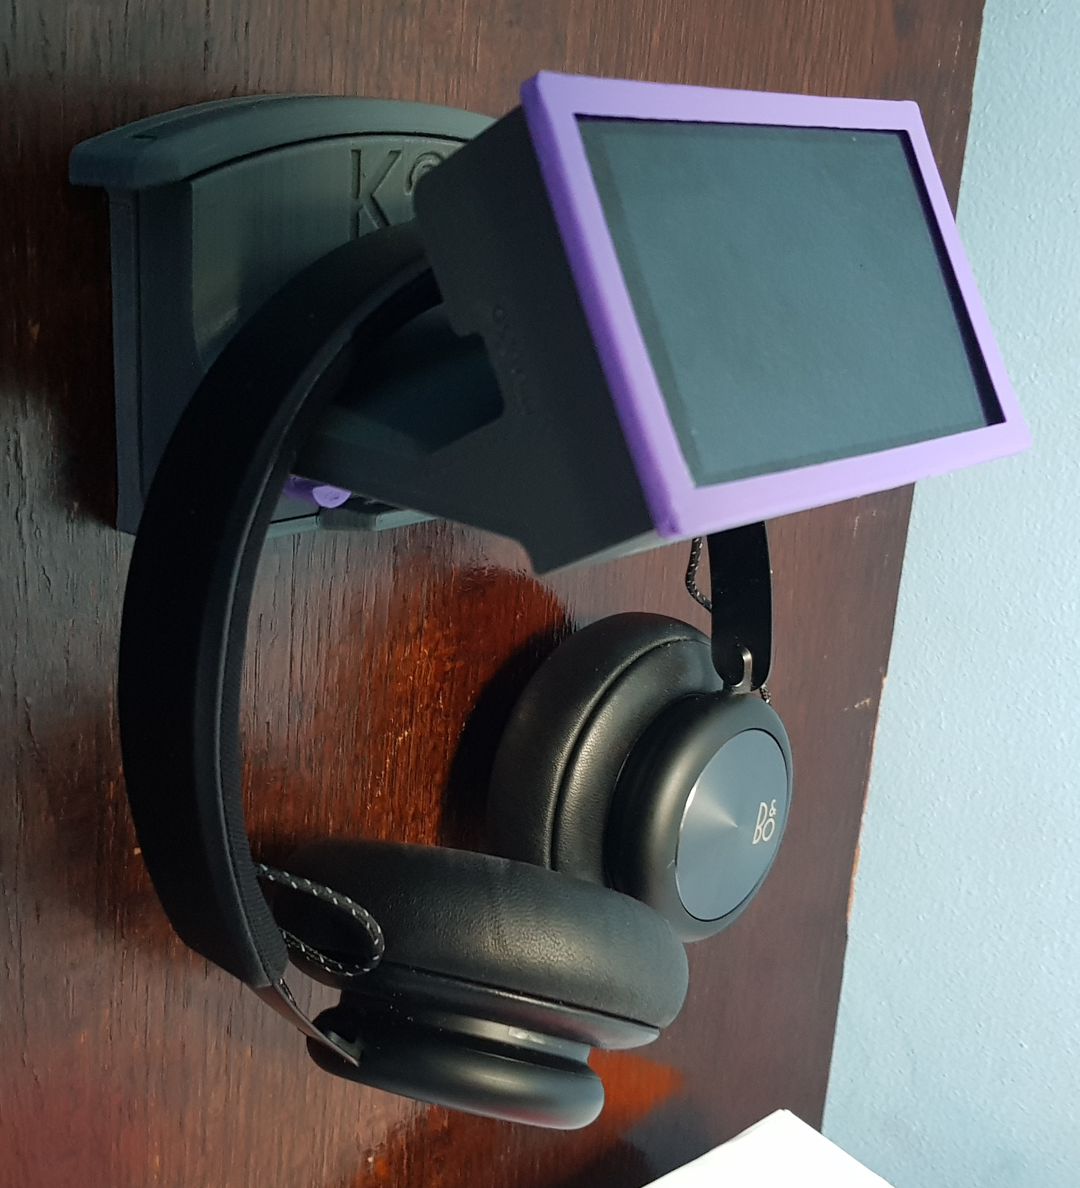
Project 1: Headphone stand with electronic interface prototyping

Slide 8
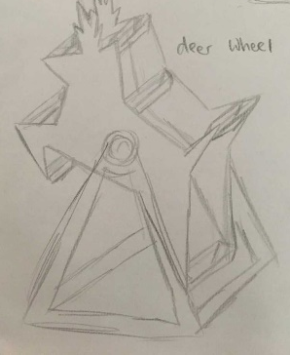
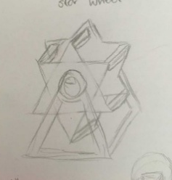
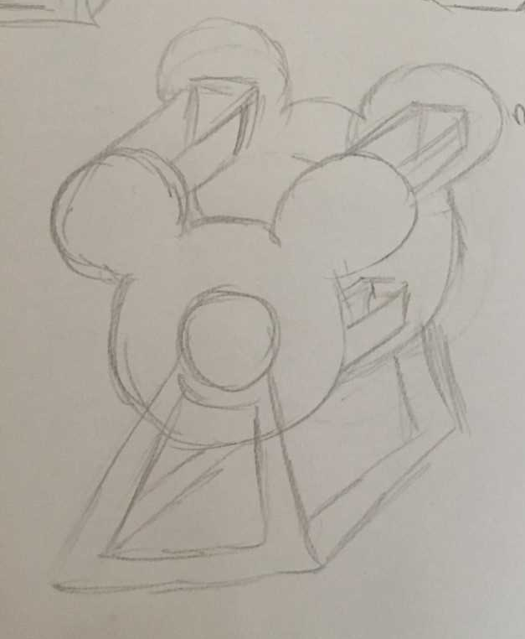
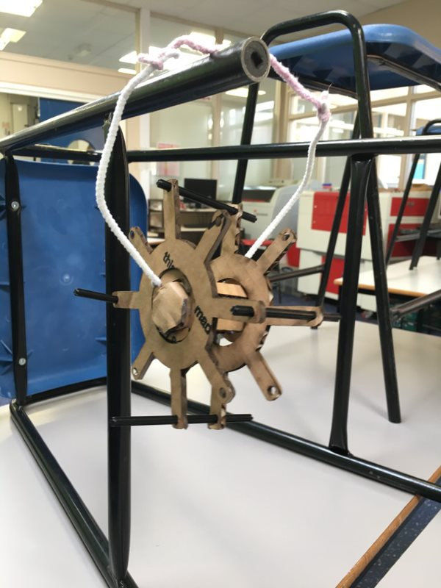
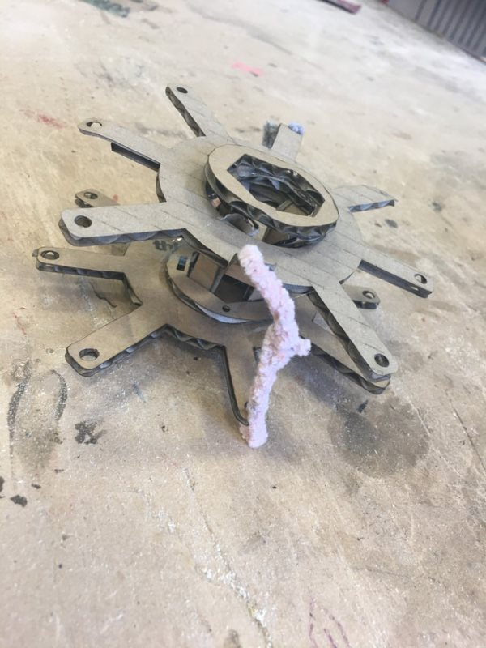
Project 2:Rotating storage Iterative process

Slide 9
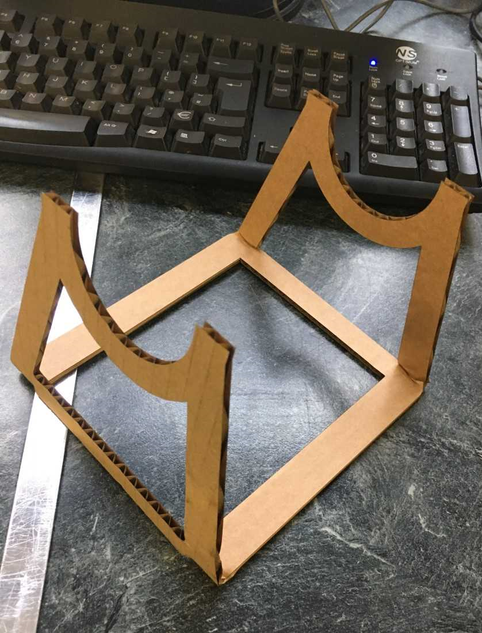
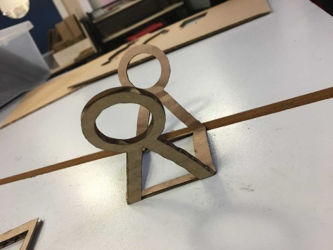
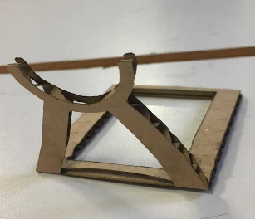
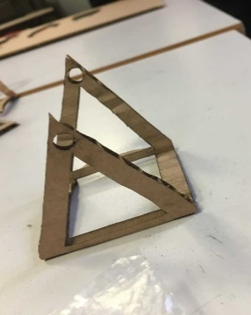
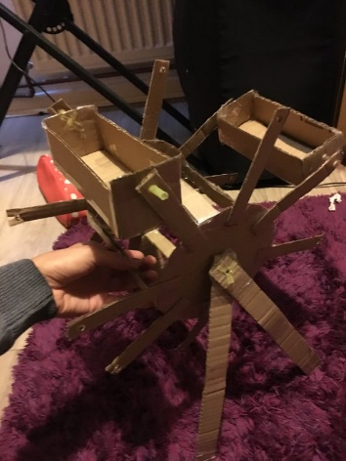
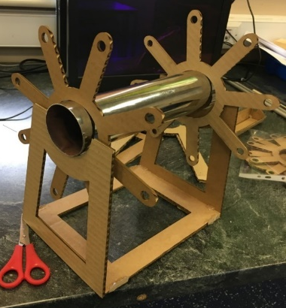
Project 2: Stand & final iterations

Slide 10
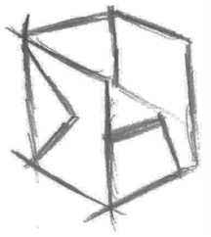
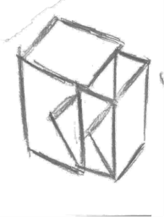
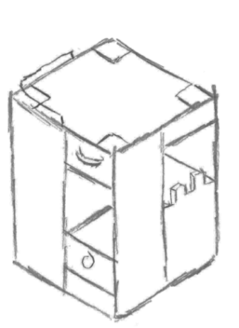
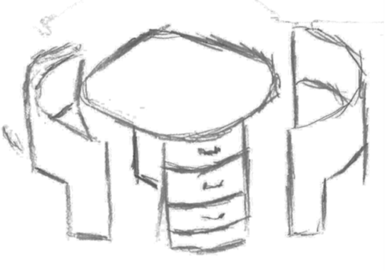
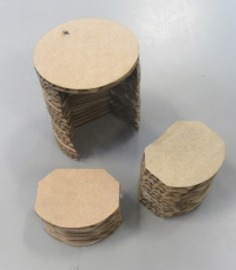
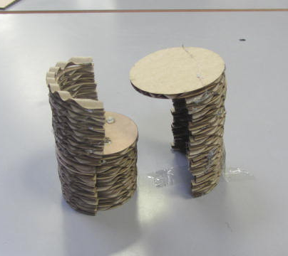
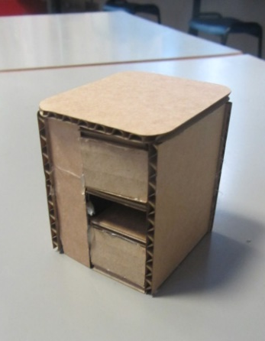
Project 3: Student desk with chair iterations

Slide 11
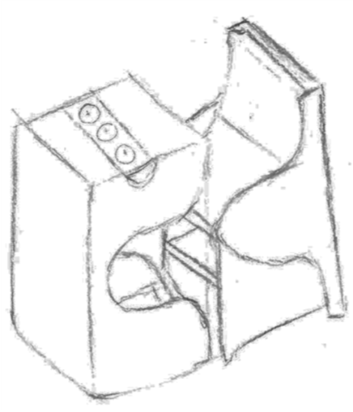

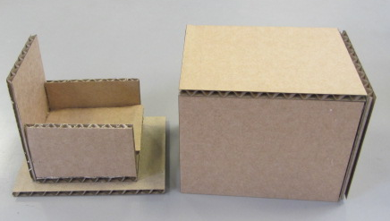
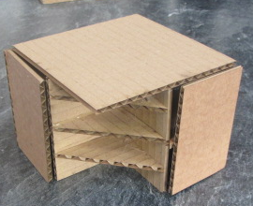


Project 3: Developmental iterations

Slide 12





Project 3: Final iteration development

Slide 13
What job could Design & Technology lead onto? …to name a few
Creative industry
Theatre/Set Designer
Television Production
Visual Communication
Graphic Designer
Web Design
Games Design
App Design
Illustrator
Advertising
Garden design
Civic design/Town planner
The list goes on….
Product Designer
Product Engineer
Architect
Entrepreneur
Engineer electrical/mechanical
Materials science
Manufacturing
CAD Designer/ CAD Engineer
Quality assurance/Quality controller
Construction industry all levels
Television/media Engineer
Traditional trades

