Slide 1

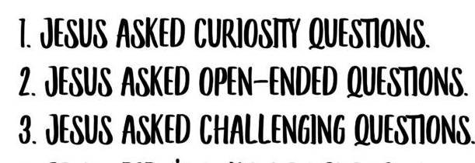
Year 9 Options 2026-2028
GCSE RE
INSERT SUBJECT BASED IMAGE IN THIS SPACE
INSERT SUBJECT BASED IMAGE IN THIS SPACE
‘Inspiring hearts and minds with Christ at the centre of all we say and do’

Slide 2
Course and Qualification Information
RE is a full GCSE course
It is a common paper – no higher or foundation levels
You will study three elements
Catholic Christianity
Judaism
Philosophy and Ethics
‘Inspiring hearts and minds with Christ at the centre of all we say and do’

Slide 3
Assessment Information
Assessment is at the end of the course through examination
Students are examined through three papers
1)Catholics Christianity 50% of the GCSE
2)Judaism – 25%
3) Philosophy and Ethics – 25%
‘Inspiring hearts and minds with Christ at the centre of all we say and do’

Slide 4
Extra Curricular Opportunities
The RE department can make activities such as Debate Club, visits to a synagogue available to students
Other options are theatre trips where there are links to the curriculum
‘Inspiring hearts and minds with Christ at the centre of all we say and do’

Slide 5
Next Steps and Career Pathways
Through your study of RE you will gain valuable knowledge and skills that are applicable to a range of careers. ​
​
Knowledge and understanding of beliefs and how they influence people’s values and actions. ​
Analysis and evaluation of argument, development of logical reasoned arguments based on fact. ​
Develops Cultural Literacy to help you to interpret the world we live in- it’s values, laws, art literature, music​
​
These skills are essential in all professions but particularly lend themselves to ​
Law, Health Care- Medicine, Psychology, Nursing, Human Resources, Education, Social Services, The Media​
​
Religious Studies is a challenging subject that requires the same accuracy of knowledge and skills set as History and English Literature. ​
It compliments Sociology, Law , English, Psychology and History at A level. ​
‘Inspiring hearts and minds with Christ at the centre of all we say and do’

Slide 6
Additional Information and Outcomes
2024
Grade 9-7 19%
Grade 9-4 73%
GCSE results in RE
2025
Grades 9-7 – 27%
Grade 9-4 60%
‘Inspiring hearts and minds with Christ at the centre of all we say and do’

Slide 7
Frequently Asked Questions
But I’m not Catholic or Christian will I be at a disadvantage? ​
No, it doesn’t make any real difference- one exam topic is about Judaism and one is about the big questions of life – philosophical and ethical. ​
We will consider different Christian perspectives, humanist perspectives. ​
Everyone will be learning together. ​
​
What if I don’t believe in God? ​
That’s not going to put you at a disadvantage, it might even help you to analyse the religious arguments put forward for the existence of God and give you the language and knowledge to support your own views​
​
Are we doing only RE because we are a faith school? ​
Yes and no, RE is a core subject because we are a faith school, but RE is a very popular options subjects in non- faith schools and is a respected GCSE subject because it is academically challenging and develops excellent higher order thinking skills. ​
​
Just like all of your subjects, RE will interest and challenge you if you are open to it. ​
‘Inspiring hearts and minds with Christ at the centre of all we say and do’

