Slide 1

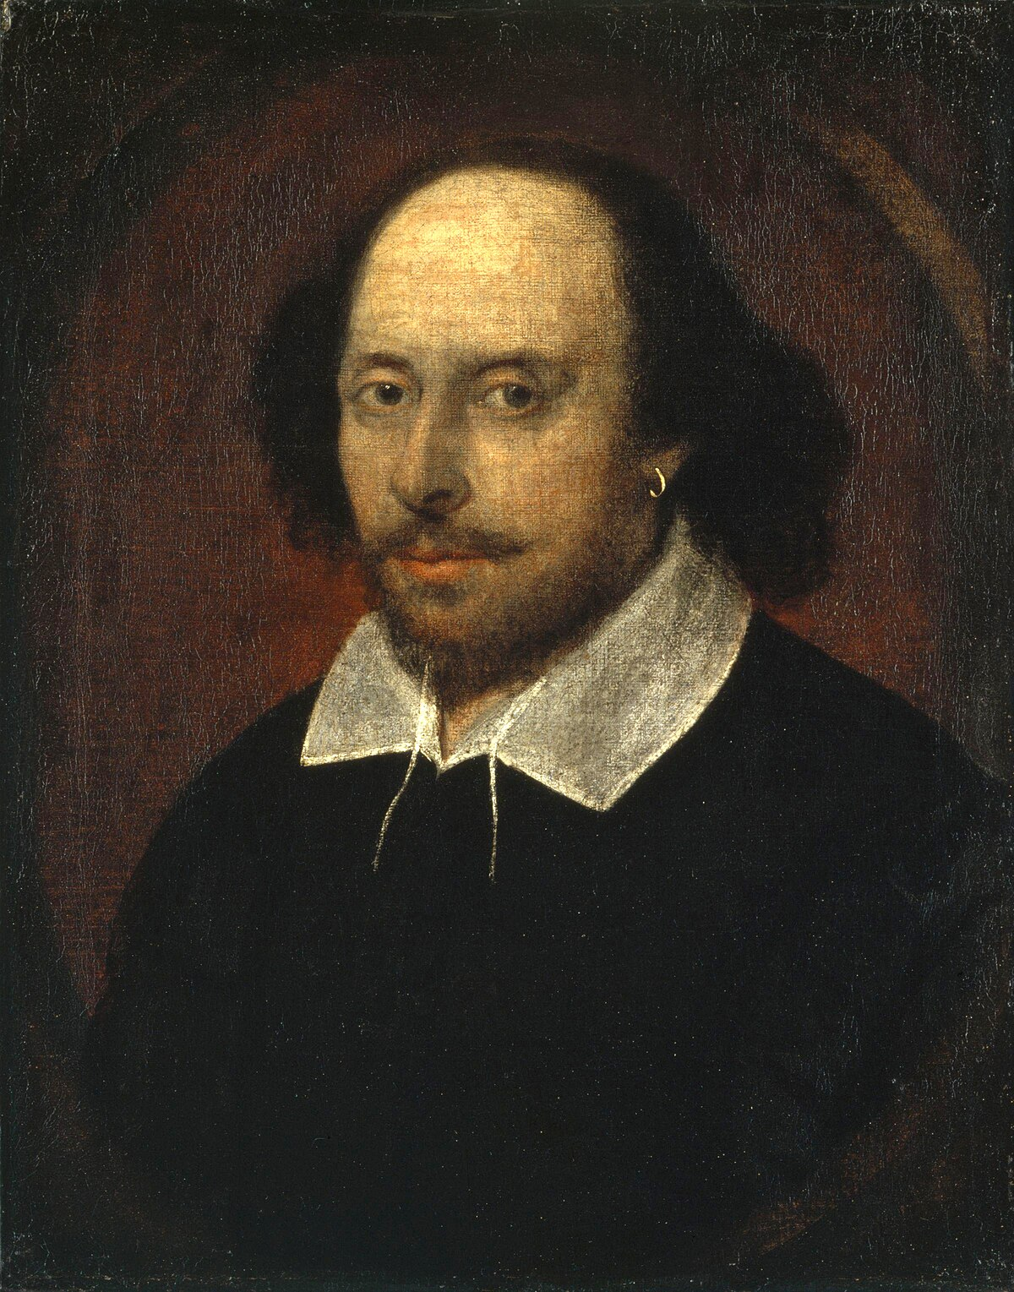
Year 9 Options 2026-2028
English
This Photo by Unknown Author is licensed under CC BY-SA
‘Inspiring hearts and minds with Christ at the centre of all we say and do’

Slide 2
Course and Qualification Information
AQA GCSE English Language
AQA GCSE English Literature
Both GCSEs are taught alongside each other during Year 10 and 11 and assessed at the end of Year 11 through external examinations.
‘Inspiring hearts and minds with Christ at the centre of all we say and do’

Slide 3
Assessment Information
English Language:
Paper 1: Explorations in Creative Reading and Writing - 1 hour 45 minutes.
Paper 2: Writers’ Viewpoints and Perspectives - 1 hour 45 minutes.
English Literature
Paper 1: Shakespeare and the 19th Century Novel - 1 hour 45 minutes.
Paper 2: Modern Texts and Poetry - 2 hours and 15 minutes.
‘Inspiring hearts and minds with Christ at the centre of all we say and do’

Slide 4
Extra Curricular Opportunities
Theatre Trips
Revision Classes
Reading Ambassadors
Librarians
Reading Mentors
‘Inspiring hearts and minds with Christ at the centre of all we say and do’

Slide 5
Next Steps and Career Pathways
Next Steps:
Most college places and apprenticeships requires students to have passed either English Language or English Literature at grade 4 and above.
Students will need to resit English Language at college if they have not achieved a grade 4 or above.
Students wishing to study A Levels will usually be required to achieve a grade 6 or above in English Language or English Literature.
Career Pathways:
The skills acquired through the study of English are required in most careers.
Education
Journalism
Media
Law
‘Inspiring hearts and minds with Christ at the centre of all we say and do’

Slide 6
Additional Information and Outcomes
In English Language and English Literature, students have historically achieved well above the national average. Below are our 2025 headline figures:
 | GCSE Language | GCSE Literature | Combined Score
9-7 | 19% | 17% | 25%
9-5 | 49% | 57% | 60%
9-4 | 71% | 75% | 77%
‘Inspiring hearts and minds with Christ at the centre of all we say and do’

Slide 7
Frequently Asked Questions
Which texts will I study as part my English Literature course?
Macbeth, A Christmas Carol, An Inspector Calls, Power and Conflict Poetry.
What is the difference between English Language Paper 1 and English Paper 2?
In English Language Paper 1 you read and write about fiction; whereas in English Language Paper 2 you read and write about non-fiction.
‘Inspiring hearts and minds with Christ at the centre of all we say and do’

