Slide 1
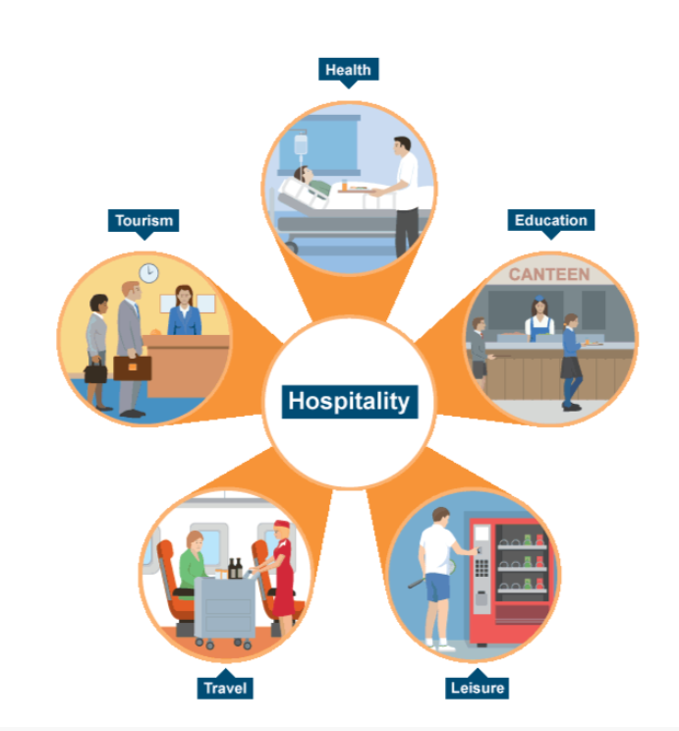
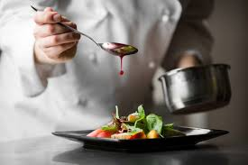

Year 9 Options 2026-2028
Hospitality & Catering
INSERT SUBJECT BASED IMAGE IN THIS SPACE
INSERT SUBJECT BASED IMAGE IN THIS SPACE
‘Inspiring hearts and minds with Christ at the centre of all we say and do’
Notes:
Slide 1 — Introduction
“Welcome to our Year 9 Options Evening!
I’m excited to introduce you to Hospitality and Catering, a creative, hands‑on subject where students learn real skills for life and future careers.”

Slide 2
Course and Qualification Information
The WJEC Level 1/2 Vocational Technical Award in Hospitality and Catering is made up of two mandatory units:
Unit 1 : The Hospitality and Catering Industry:- This unit enables students to gain and develop comprehensive knowledge and understanding of the hospitality and catering industry including provision, health and safety, and food safety.
Unit 2 : Hospitality and Catering in Action:- This unit enable students to develop and apply knowledge and understanding of the importance of nutrition and how to plan nutritious menus. They will learn the skills needed to prepare, cook and present dishes. They will also learn how to review their work effectively.
‘Inspiring hearts and minds with Christ at the centre of all we say and do’
Notes:
Slide 2 — Course Overview
“This course includes two main units:
Unit 1 explores the world of hospitality—jobs, safety, and how the industry works.
Unit 2 is where the fun really happens: planning meals, cooking dishes, and learning how to present food professionally.”

Slide 3
Assessment Information
Unit 1: The Hospitality and Catering Industry
Written examination: 1 hour 20 minutes
40% of qualification
80 marks
Questions requiring short and extended answers, based around applied situations. Students will be required to use stimulus material to respond to questions.
Unit 2: Hospitality and Catering in Action
Controlled assessment: approximately 12 hours
60% of qualification
120 marks
An assignment brief will be provided by WJEC which will include a scenario and several tasks.
Grades are awarded on an 8-point scale: Level 2 Distinction*, Level 2 Distinction, Level 2 Merit, Level 2 Pass, Level 1 Distinction*, Level 1 Distinction, Level 1 Merit, Level 1 Pass
‘Inspiring hearts and minds with Christ at the centre of all we say and do’
Notes:
Slide 3 — Assessment
“Assessment is split between a written exam and a practical controlled assessment.
Students cook, plan menus, problem‑solve and show off their practical skills.
Grades range from Level 1 Pass all the way up to Level 2 Distinction*.”

Slide 4
Extra Curricular Opportunities
1. Visit to University College Birmingham (UCB)- Showing students how University College Birmingham can help launch their hospitality and catering careers with an exclusive kitchen taster day where they will be cooking with a chef. Perfect for aspiring chefs, bakers and culinary professionals!
2. Joint curricula trip with Food and MFL departments to France.
3. After school revision sessions.
‘Inspiring hearts and minds with Christ at the centre of all we say and do’
Notes:
Slide 4 — Enrichment
“We offer amazing opportunities—like a professional chef taster day at UCB, a fantastic trip to France, and extra after‑school support sessions. There’s lots to get involved in!”

Slide 5
Next Steps and Career Pathways
The course also enables students to access Level 3 qualifications relevant to the hospitality and catering sector, such as: WJEC Applied Certificate / Diploma in Food, Science and Nutrition; Level 3 Diploma in Hospitality and Tourism Management. Students will be able to access a wide range of exciting career opportunities including, Chef de Partie, Commis chef, Concierge, Executive chef, Front of House Manager, Receptionist, Head waiter, Food Technologist Read inspiring career journeys here: www.foodafactoflife.org.uk/whole-school/careers | Students will develop a range of skills which are attractive to employers, colleges, and universities including: Communication Confidence Learning independently Organisation Problem solving Research Taking on responsibility Time management.
‘Inspiring hearts and minds with Christ at the centre of all we say and do’
Notes:
Slide 5 — Future Pathways
“This subject opens the door to Level 3 courses and exciting careers: chef, front‑of‑house manager, receptionist, food technologist and more!
Students also build key skills—communication, confidence, organisation, and independence.”

Slide 6
Additional Information and Outcomes
The course is a technical award – designed to equip students with practical, transferable skills and core knowledge they need to progress to further general or vocational studies , including level 3 qualifications, employment or apprenticeships
Students will need to bring in ingredients on a weekly to fortnightly basis when making products as Hospitality and Catering is a practical subject however practical work will be supported by written work.
Students will need to complete written independent learning tasks which include research on specific topics such job roles within the industry; legislation governing the industry etc
‘Inspiring hearts and minds with Christ at the centre of all we say and do’
Notes:
Slide 6 — What to Expect
“Hospitality and Catering is practical and engaging.
Students bring ingredients regularly and complete short independent tasks to deepen their knowledge.”

Slide 7
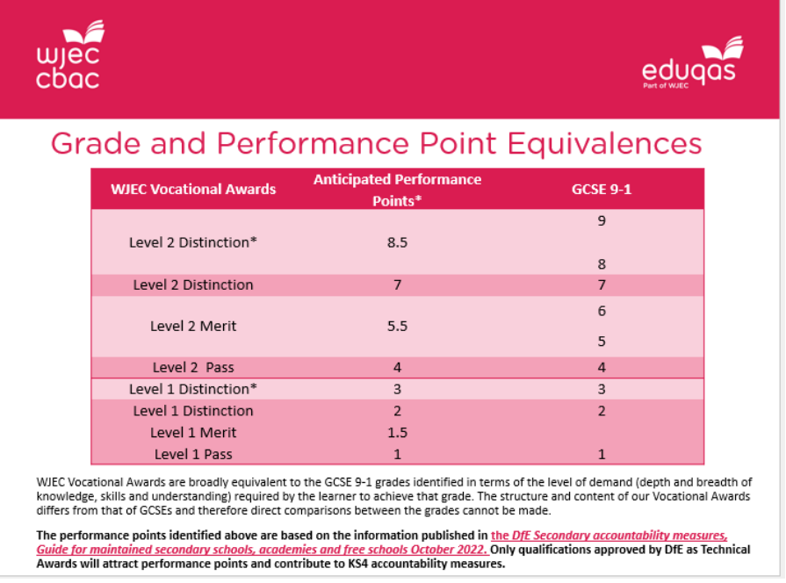
Frequently Asked Questions
What is the Grade Equivalent for
this course to GCSE grades?
2. What do I need to do in order to be successful in this course?
Answer:
Cook for your family regularly - try new recipes,
complete homework task,
be creative in adapting and presenting dishes,
use past papers provided to support you with revision.
Source: https://www.wjec.co.uk/media/otihbofx/hc-faqs.pdf
‘Inspiring hearts and minds with Christ at the centre of all we say and do’
Notes:
Slide 7 — Frequently Asked Questions
“To do well in this course, students should cook at home when they can, try new recipes, and be creative when preparing and presenting dishes.
Homework and past paper practice really help too.
And if you’re wondering about grades — this qualification has direct GCSE equivalents, so students can achieve strong, recognised results.”

