Slide 1
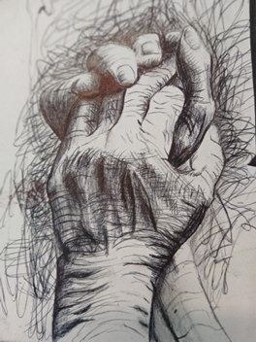
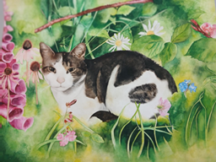
Year 9 Options 2026-2028
Art and Design
INSERT SUBJECT BASED IMAGE IN THIS SPACE
INSERT SUBJECT BASED IMAGE IN THIS SPACE
‘Inspiring hearts and minds with Christ at the centre of all we say and do’

Slide 2
Course and Qualification Information
The OCR GCSE (9-1) Art and Design course (J170–J176) consists of two components: a 60% Portfolio (coursework) and a 40% Externally Set Task (exam).
The course focuses on practical skills, artist research, and personal responses. The course emphasizes creative development, culminating in a 10-hour practical exam.
Course Structure
Component 01: Portfolio (60%): This unit includes a "sustained project" and a selection of other work, covering a wide range of materials and techniques, such as drawing, painting, photography, and digital technologies. It involves developing a personal portfolio based on a starting point or topic, usually starting in Year 10.
Component 02: Externally Set Task (40%): Students choose one starting point from an exam paper released by OCR in January of Year 11. They have a preparation period followed by a 10-hour sustained, focused study period to create a final piece.
‘Inspiring hearts and minds with Christ at the centre of all we say and do’

Slide 3
Assessment Information
Component 01: Portfolio (non-exam assessment)
Worth 60% of total GCSE.
Demonstrates evidence of all four assessment objectives:
AO1: Develop ideas with critical/contextual understanding.
AO2: Refine work through experimentation.
AO3: Record observations and ideas.
AO4: Present meaningful and personal outcomes.
Component 02: Externally Set Task
Worth 40% of total GCSE.
Externally set paper issued in January of the examination year.
Preparation period followed by 10 hours of supervised time.
Students create a personal final piece informed by preparatory work.
Must meet all four assessment objectives.
Marked by the centre and moderated externally.
‘Inspiring hearts and minds with Christ at the centre of all we say and do’

Slide 4
Extra Curricular Opportunities
Lunchtime art club
After school portfolio catch-up sessions
Articulation Discovery Day at Wolverhampton Art Gallery
Studio visit and workshop with local photographer
‘Inspiring hearts and minds with Christ at the centre of all we say and do’

Slide 5
Next Steps and Career Pathways
Career Pathways and Specialisms
Design: Architect, Graphic Designer, Fashion Designer, Interior Designer, Product Designer, Games Designer.
Media & Digital: Animator, Concept Artist, Photographer, Filmmaker.
Arts & Culture: Fine Artist, Curator, Art Therapist, Community Arts Worker.
Commercial & Technical: Advertising Art Director, Illustrator, Set Designer, Technical Illustrator.
Previous art students from Bishop Milner Catholic College have gone on to study fine art, graphic design, architecture, interior design, fashion, illustration, furniture design, transport design, film making and photography.
‘Inspiring hearts and minds with Christ at the centre of all we say and do’

Slide 6
Additional Information and Outcomes
Where will GCSE Art and Design take you?
You can continue your art and design studies at A-level.
If you don’t want to take your art and design studies any further, the transferable skills you gain will still be valuable.
You’ll develop problem solving, creative thinking, investigation, research, communication and teamwork skills, and gain the ability to develop, refine and present ideas.
Employers and universities regard all of these skills highly.
‘Inspiring hearts and minds with Christ at the centre of all we say and do’

Slide 7
Frequently Asked Questions
Is GCSE Art difficult?​
Art is demanding, requires hard work and teachers base the marks on the quality of your work… practise makes perfect!​
You will need to put in the time both in school and at home.
What if I can’t draw!
Drawing is part of the course, but so is taking photographs, experimenting with different materials and techniques, such as printing, 3d work and textiles. Everyone will find a skill they can work confidently with.
Do I need to be organised?​
Yes, the more organised you are, the easier you will find the course.
Is there lots of writing?​
Artist analysis is part of the course, but this can be done in many ways. You can make bullet pointed notes or pieces of work in the artist’s style.​
There is no essay writing and no final written exam.​
‘Inspiring hearts and minds with Christ at the centre of all we say and do’

