Slide 1

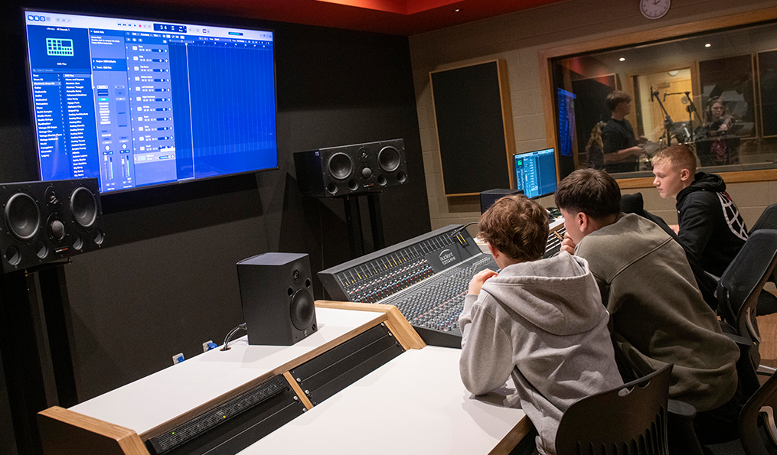
Year 9 Options 2026-2028
Music
‘Inspiring hearts and minds with Christ at the centre of all we say and do’

Slide 2
Course and Qualification Information
Qualification: Pearson BTEC Level 1/Level 2 Tech Award in Music Practice
Level: Equivalent to GCSE (Levels 1–2)
Duration: 2 years (Key Stage 4)
Total Qualification Time: 140 hours (120 guided learning hours)
This course is a practical, skills-based qualification designed for students who enjoy creating, performing or producing music. It focuses on developing real-world music skills using professional-style projects and industry contexts.
The course develops:
    Musical skills and techniques
    Creativity and problem-solving
    Personal skills such as time management and teamwork
What you will study:
  You will complete three components:
  Component 1: Exploring Music Products and Styles
      Learn about different genres and styles of music
      Explore how music is created (performance, production, composition)
  Component 2: Music Skills Development
      Develop skills in performance, composition and/or production
      Track your progress and improve your techniques
  Component 3: Responding to a Music Brief
      Create a final piece of music based on a real industry-style brief
      Work as a performer, producer or composer
‘Inspiring hearts and minds with Christ at the centre of all we say and do’

Slide 3
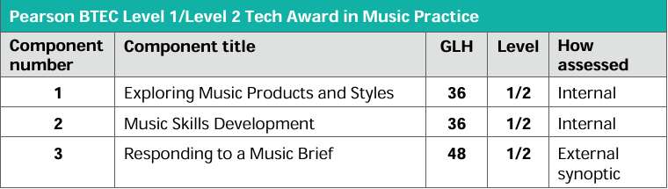
Assessment Information
Key Assessment Details:
Coursework completed in class under supervision
External task includes:
  Preparation period (around 12 weeks)
  Final supervised assessment (around 3 hours)
There is no traditional written exam, but you will:
Plan and develop ideas
Create music
Evaluate your work
‘Inspiring hearts and minds with Christ at the centre of all we say and do’

Slide 4
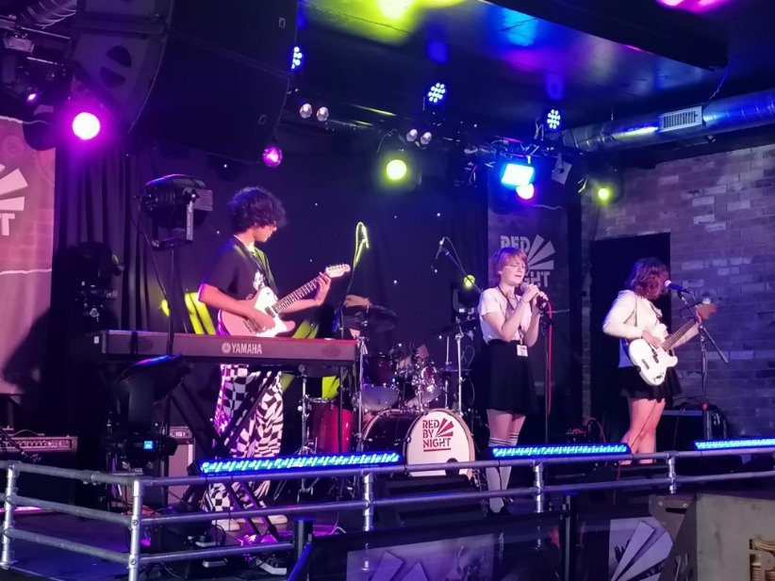
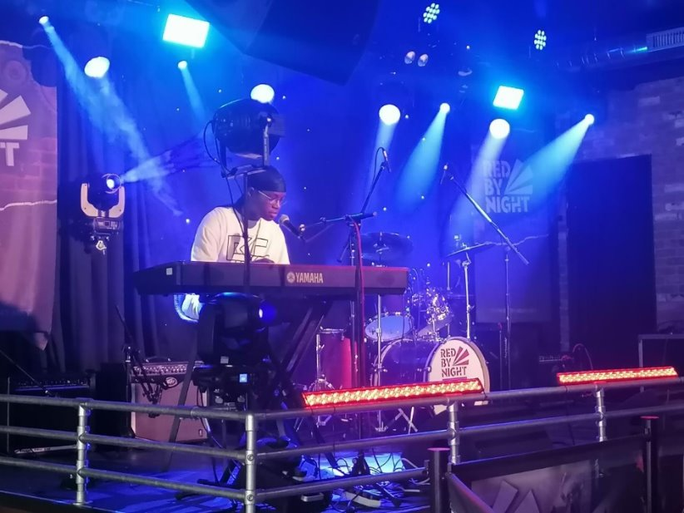
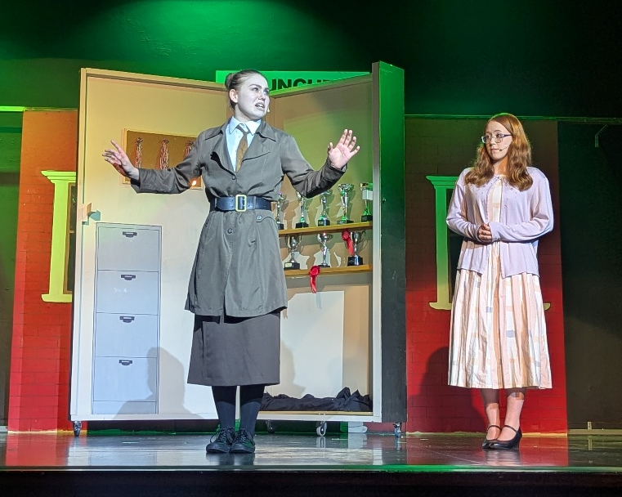

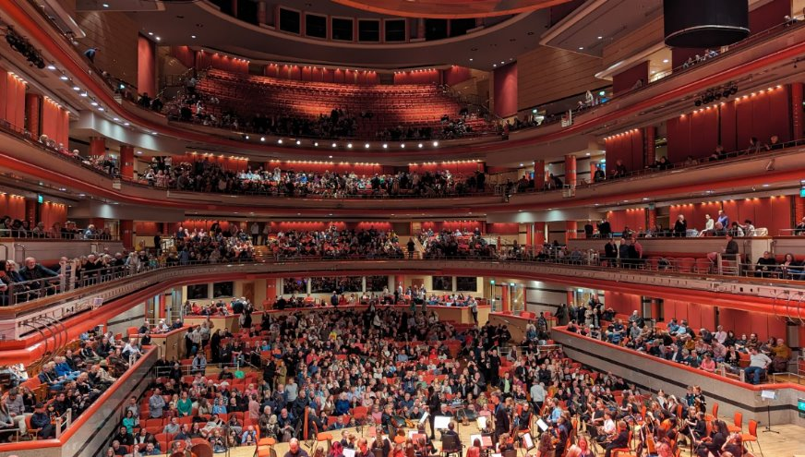
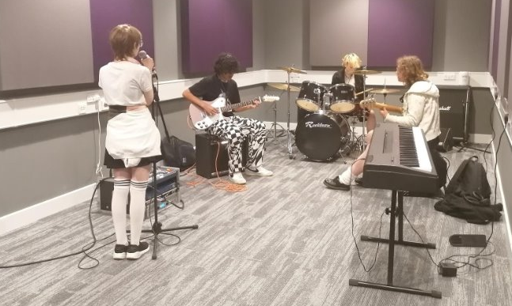
Extra Curricular Opportunities
School Production
Performance Opportunities – Assembly, Mass, Concerts and more
Band Practice
Choir
Opportunities through Dudley Performing Arts
Instrumental Tuition
‘Inspiring hearts and minds with Christ at the centre of all we say and do’

Slide 5
Next Steps and Career Pathways
The music industry is large and growing, supporting over 190,000 jobs in the UK.
The BTEC Music Qualification could lead to a career in Performance, Recording, Music Production, Music Business, Band Management, Music Journalism, Music Therapy, Teaching and many more careers.
The BTEC Music Qualification allows you to progress to, Level 3 RSL and BTEC Music / Music Technology courses, A Level Music and Music Technology courses, and higher education courses such as degrees in Music, Popular Music, Music Technology and Music Business.
‘Inspiring hearts and minds with Christ at the centre of all we say and do’

Slide 6
Additional Information and Outcomes
What skills will you gain?
By the end of the course, you will:
Perform, create or produce music confidently
Understand different musical styles and techniques
Work independently and as part of a team
Develop industry-relevant skills like planning and communication
What makes this course different?
Focus on practical learning rather than exams
Learn through realistic music industry scenarios
Build a portfolio of work
Is this course right for you?
This course suits students who:
Enjoy music and creativity
Prefer practical work over written exams
Are interested in technology and production
Want to explore careers in music
You should be able to play an instrument or sing and want to develop your skills further. ​
If you do not play an instrument yet and would still like to take BTEC music, we would decide on an instrument for you to learn with Dudley Performing Arts in the first term.
Instruments offered: (Instrument hire can be arranged)
Vocals
Keyboard
Guitar
Bass Guitar
Violin / string instruments
Brass instruments
Woodwind instruments
Drums
‘Inspiring hearts and minds with Christ at the centre of all we say and do’

Slide 7
Frequently Asked Questions
Q: Do I need to play an instrument?
A: Not right now. If you have an instrument in mind (i.e., Guitar, Keyboard, Vocals, Drums) you can start learning in year 10. However, students who already have an instrument that they can play will find elements of the course easier.
Q: Do I have to perform in front of others?
A: Performance is part of the course, so you will be performing in front of your peers.
Q: How many lessons a week?​
A: Currently, I see year 10 5 times over 2 weeks. Of course, this may change next
year but it will likely be the same!​
Q: Do I have to be able to read music?​
A: No, although it does help! Within lessons, we will work on building your notation
and music theory skills.
Q: Is it all practical?
A: Mostly, but you will also explain and evaluate your work as part of coursework, create written portfolios and complete other written tasks.
Q: Is there an exam?
A: There is no traditional written exam, but there is an externally assessed project at the end of year 11.
Q: What equipment will I use?
A: Instruments, recording equipment and music software (DAWs).
‘Inspiring hearts and minds with Christ at the centre of all we say and do’

